Slide 1
Zero Waste 3-D Fashion Design
Shenkar, Israel, ESITH Morocco, FAD Dubai
Supported by the American embassy Jerusalem
Lecturers: Gilli Bahat-Eshkol and Ana Sol
Internationalism and coordination: Dr. Ruti Bardenstein

Slide 2
What does the course promote?
Technological innovation
Internationalism
Culturalism
EMI
Abraham Accords Spirit
Innovative Art and Design

Slide 3
Some facts
The fashion industry is the second largest source (2nd to the oil industry) of environmental pollution.
Every year tons of textiles are dumped globally and pollute the environment.
Fashion corporations, along with the advertising industry, encourage us to consume clothes so we all throw more and more, ignoring the environmental consequences.

Slide 4
What do we do to solve this?
Global, Inter-Cultural, Sustainable Fashion which is the key to reducing damage to the environment and for people, leading the change in the fashion industry.
Existing practices in sustainable fashion include:
--increasing the value of local production;
--extending product life and raw materials;
--reducing consumption, overproduction, waste, and environmental damage;
--conducting innovative development and production processes, both during the use and at the end of a product's life.

Slide 5
The uniqueness of our project
The aim of the project is global cooperation in the spirit of the Abraham Accords (between the US, Morocco, the Emirates and Israel) in order to increase awareness of sustainable global fashion inter-culturally (which aims to create a balance between the industry, the environment and different communities) and to take a practical part as the designers of the future in the process of encouraging change in the fashion industry and its products as well as work together inter-culturally towards change.
From the design and planning stage: Zero waste design technique eliminates the creation of textile waste.
The course is fully online and digitally-oriented

Slide 6
Content and aims
The project focuses on collaborative work, in the spirit of the Abraham Accords, taking into consideration the difference fashion styles and the different cultures. Israel and the US clearly have a different culture of clothing than that of the Emirates and Northern African countries. This issue was taken into account for the purpose of collaborative and fruitful work for all involved.
The design and development of the models used translations of traditional design tools into digital, 3D, rendering CLO3D studies.
Using the digital tools of the raw materials, developing dressing patterns and using digital sawing techniques that match the designing idea and the desired look of the outfit (virtual).
For weekly progress, a MIRO board was used
EMI and Internationalism

Slide 7
The main aims
Practicing and learning basic skills of the CLO3D program, including 3D rendering.
Designing and executing a 3D virtual capsule.
Executing a virtual fashion production (show, set, footage, presentation etc.)
Using CLO3D to produce technical product specification
Using textile planning and print based on the engineered pattern.
The 3-D Zero Waste Fashion Design course creates Fashion designs and fashion shows that include avatars, rather than live models.

Slide 8
Some pictures from the preparation sessions

Slide 18
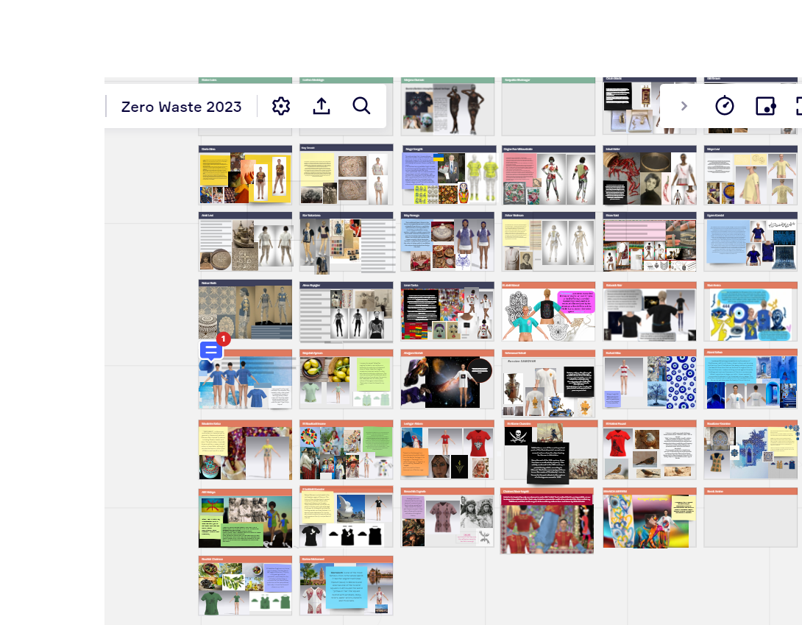
a digital 3D fashion project in the spirit of the Abraham Accords:
A Miro Board :
https://miro.com/app/board/uXjVPjLscpI=/?utm_source=notification&utm_medium=email&utm_campaign=daily-updates&utm_content=go-to-board

Slide 21
Final product: Example
https://www.instagram.com/tv/CZJ9kzLsU0M/?igshid=MDJmNzVkMjY=

