Slide 1

Teachers as design scientists: Collaborating on innovation in blended learning
Diana Laurillard
Professor of Learning with Digital Technology,
UCL Knowledge Lab, University College London
Notes:
… Thanks to MEITAL for the invitation. Very much looking forward to our discussion on this approach

Slide 2

Educators collaborating to innovate - Outline
What do students need from EdTech?
Support for active and social learning
Who will develop the new digital pedagogies?
→ Trust the teachers to do this development
What do teachers need?
Time! And support do it collaboratively
What do students need from EdTech?
Support for active and social learning
Who will develop the new digital pedagogies?
→ Trust the teachers to do this development
What do teachers need?
Time! And support do it collaboratively
Notes:
…
- Support
- Trust
- Time and support
But how do we put that idea into practice, of teachers collaborating to innovate? I've organised the talk around these basic challenge questions...

Slide 3

How does digital technology improve learning?
Learning through
Inquiry/Investigation
Discussion
Practice
Collaboration
Production
Notes:
How do digital pedagogies improve learning? To answer that we really have to be clear about what we mean by active and social learning. So I go back to the basic question of what it takes to learn, and go from there, to consider first these 5 different types of active learning: and social learning through
Inquiry
Discussion
Practice
Collaboration
Production
Then we can see what difference digital methods can make.

Slide 4
The Conversational Framework: What does it take to learn?
Derived from theories and research on learning and teaching
w
To represent the teaching-learning process as
a series of iterative exchanges
between the learner and a ‘teacher’ and
between a learner and their peers
at two levels of concepts and practices
in any context.
(Laurillard, 2002, 2012)
Then: we can decide how technology could help
Notes:
Why developed ...
- and once we've established what it takes to learn in formal education, we can turn to deciding how technology could help.
[Laurillard, D. (2002). Rethinking University Teaching: A Conversational Framework for the Effective Use of Learning Technologies (2nd ed.). London: RoutledgeFalmer.
Laurillard, D. (2012). Teaching as a Design Science: Building Pedagogical Patterns for Learning and Technology. New York and London: Routledge.]

Slide 5
The Conversational Framework: What does it take to learn?
Acquisition
Teacher concepts
Inquiry
Learner concepts
Peer concepts
L
C
L
C
Discussion
Producing
Practising
Learner practice
Collaborating
Learning environment
L
P
L
P
Peer practice
Derived from educational research on how students learn: all these types of learning work together to complement and enhance each other
Notes:
This framework shows how each of 6 learning types is a distinctive way for the teacher to promote those recurring cycles of concept and skill development.
- Acquisition, where the student is reading, or watching a presentation, or listening to the teacher, and that helps them change and develop their concepts. The other learning types are different because they all involve deliberate activity by the learner – they are all types of active learning:
- Inquiry, where the learner drives the investigation of ideas and concepts, with feedback from the teacher, or the book.
- Practice, where the learning environment helps students exercise their concepts and skills, giving them feedback so they can improve both.
- Discussion, or debating and exploring ideas, giving feedback to each other.
- Collaboration, where they’re practicing, and discussing, and sharing their practice, and
- Production, where they link concepts and practices to produce something for the teacher or others to assess.
What we try to do as teachers is to keep those cycles moving, each one encouraging the learner to think, to react, to experiment, to argue, to create and to reflect. And that’s how we help them develop their concepts, and practices, and the relations between them.

Slide 6
How do technologies help? Conventional methods
Presentations
Reading
Acquiring
Teacher concepts
Teacher communication cycle
Learner concepts
Peer concepts
L
C
L
C
Discussion
Inquiring
Discussion groups
The library
Write a report
Producing
Teacher modelling
cycle
Peer
modelling
cycle
Group projects
Labs, Exercises
Collaborating
Learning environment
Practising
L
P
Peer practice
Learner practice
L
P
These learning types are encouraged through a variety of conventional methods
Notes:
We can represent the wide range of methods we use in conventional teaching and learning – the technologies of
Teacher presentations, or reading,
The library for inquiry
Labs or exercises for practice
Discussion groups,
Group projects for collaborating,
And writing a report to show what has been learned.
And as teachers we try to encourage all these types of learning.

Slide 7
How do technologies help? Digital methods
Digital images
Animations
Acquiring
Learner concepts
Discussion
Teacher concepts
Explore the internet
L
C
L
C
Text chat
Menti
Peer concepts
Inquiring
Make website
Producing
Test a digital model
Quiz
Teacher modelling
cycle
Peer
modelling
cycle
Collaborating
Learning environment
Practising
L
P
L
P
Draft a wiki
Peer practice
Learner practice
The same learning types are encouraged also through a variety of digital methods
Notes:
With digital methods we have a much wider range of pedagogies we can use for learning. This is just a small selection:
For acquisition, Using digital images or videos,
For inquiry, exploring the internet,
For practice, testing a digital model – where the digital environment itself is giving the students feedback on their actions, to help them improve,
For discussion, using text chat or Mentimetre,
For collaboration, making a digital object, like drafting a wiki,
and for production, maybe making a website or a slideshow.
With digital and online technologies we have a huge new toybox of intriguing ways of supporting these different types of learning. Lets look at each learning type in turn, and what digital methods can do for each one.

Slide 8
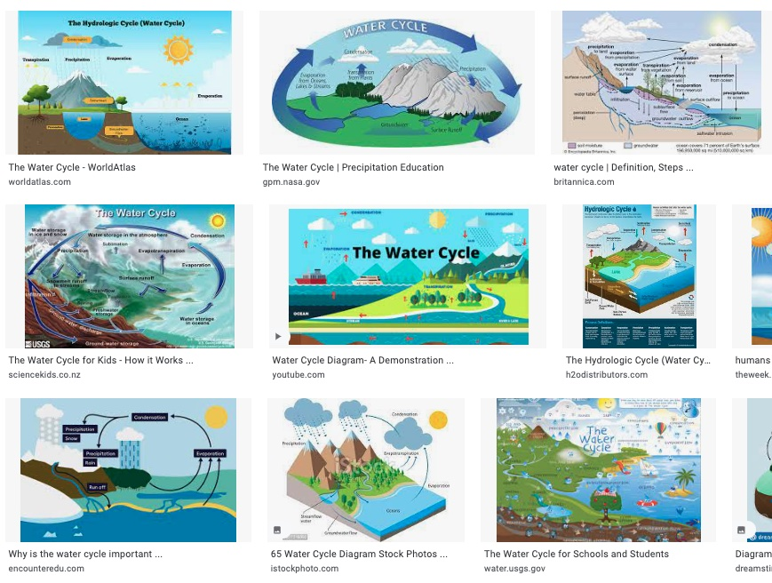
Learning through inquiry
Alternative representations of scientific concepts images and animations assist understanding at any level – giving students agency to discover
Notes:
Exploring contrasting ideas and ways of representing them – I tried looking for alternative perspectives on the science topic of the water cycle – masses of images, some interactive to a degree, many could transform a teacher’s presentation, or a student’s exploration to improve their understanding.

Slide 9
Learning through discussion
Every student can respond to the teacher’s question on a Menti site, for the teacher to talk through and give feedback
Notes:
Normally only one or two students can answer a teacher’s question. With a Menti site everyone can be asked to contribute, the class can look through all ideas later, and the teacher can check how many responded.

Slide 10
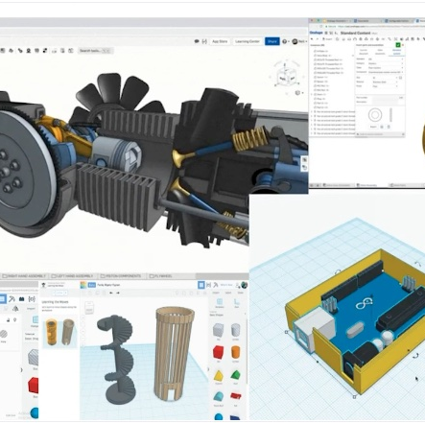
Learning through practice
Digital models and simulations enable students to explore embodied concepts for ‘situated learning’
Notes:
Engineering students exploring and presenting an optimized CAD modelling tool for developing their design concepts

Slide 11
Practice with meaningful feedback
A program is the ultimate digital model
Students interact with a model of a task or process, and see what happens as a result
Source: University of Colorado, Boulder
Notes:
Students working with an interactive model of how the parameters in an energy system combine to create results in terms of its outputs, can test their understanding of the system by trying to create specified outputs by manipulating the inputs. They do not need to be told whether they got their inputs right – they can see whether they got the output they intended. That’s meaningful feedback – and that’s how we learn about the world from day 1. It’s what the health simulation talk this morning referred to as ‘experiential learning’.

Slide 12
Learning through collaboration
Students use a Padlet wall to collaborate by showing and commenting on what they have found on a topic – promoting constructivism
Notes:
In this case the Padlet is being used for teachers to share the ways in which they use different digital tools in creating activities for their students.

Slide 13
Learning through production
Teachers’ presenter tools also enable students to express what they know or have learned
Notes:
Whatever technologies teachers use can be used by students too.
PPT, for example, is being used here by a grade 10 teacher to get students to design a sacred building, using what they know about the key features to include. The students then share their presentations in their class online space.

Slide 14
Optimal ways to integrate digital pedagogies into teaching and learning?
Learning through
Inquiry
Discussion
Practice
Collaboration
Production
Acquisition
Menti.com: 7782 7954
Notes:
All those are examples of ways in which digital methods support the different types of active learning.
- Of course, there is also ‘Learning through acquisition’, learning from the teacher’s presentation. Learning from reading, watching or listening. This is where the student is not actively deciding what to do so much as following what is presented. All these distinctive types of learning are derived from the Conversational Framework. But how do we optimise the way we use all the new methods now available to us? We have the tradition of lesson planning, of course, but now we’re talking more about ‘learning design’, a design that looks at the plan from the learner’s point of view, that asks ‘what are they doing to learn?’ For this we need to focus in detail on how to design the learning and teaching sessions we plan for our students, both in class and beyond the classroom.
USE MENTI POST QUESTIONS
https://www.menti.com/alc94d1getb1

Slide 15
Learning design: Enabling teachers to innovate
Designing activities for learning
Building on what you know
Articulating your design of what students DO
Analyzing a learning design
Optimizing digital methods for learning
Evaluating learning designs
Sharing learning designs
Menti.com: 7782 7954
Notes:
For this we need to look at ‘Learning Design’ - a way of making your pedagogic ideas very explicit. Different from ‘instructional design’ in the sense that it looks at the design of the teaching-learning process from the learner’s point of view. Like the Conversational Framework, it is asking the question ‘what does it take to learn?’ – what must the student DO in order to learn? Asking this question is important because it formalises a way for teachers to innovate by sharing their ideas of how they can do that. Learning design supports the process of:
Designing activities for learning
Building on what you know
Articulating your design of what students DO
Analyzing a learning design
Optimizing digital methods for learning
Evaluating learning designs
Sharing learning designs
So how do we do this?

Slide 16
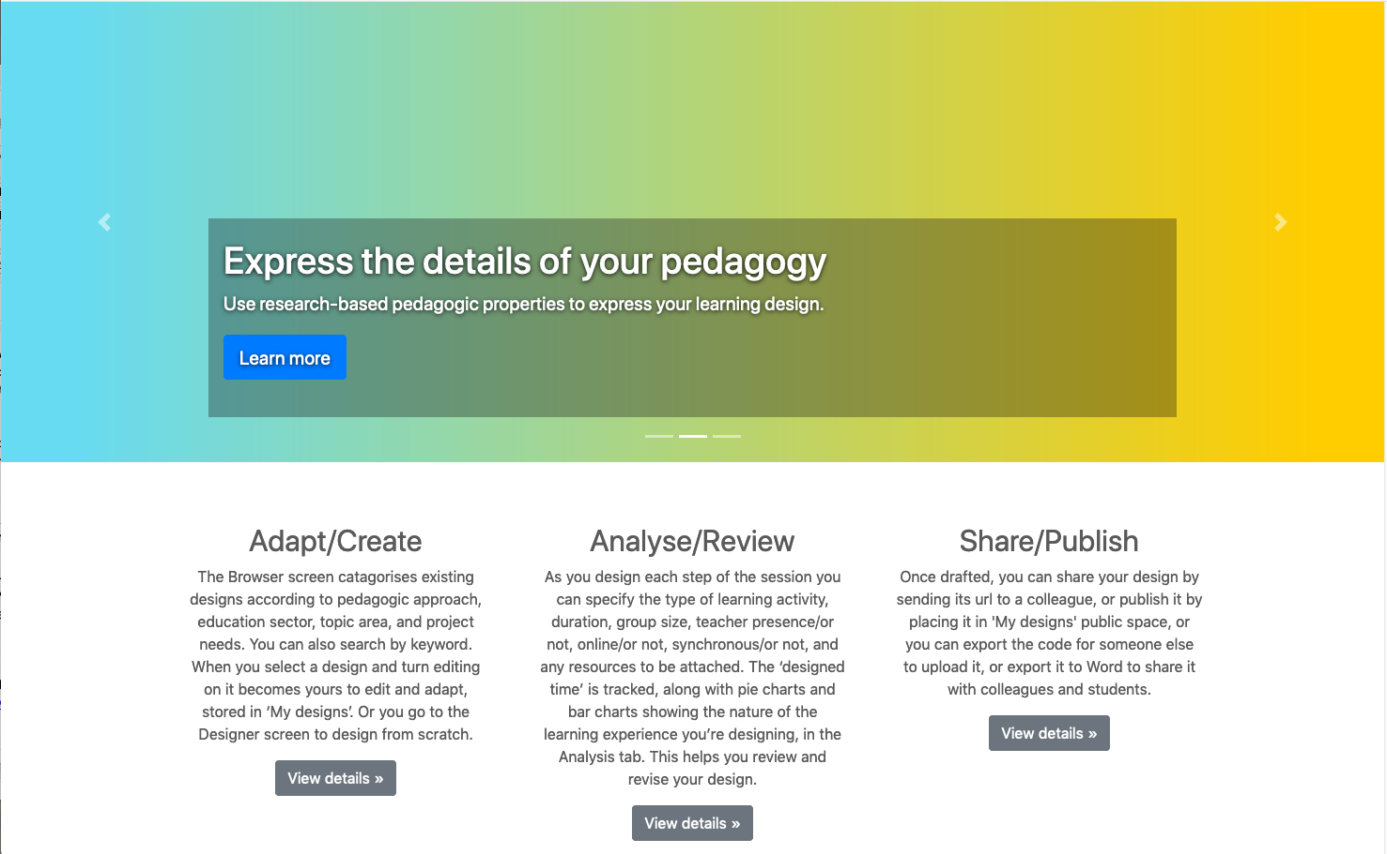
Designing activities for learning
https://www.ucl.ac.uk/learning-designer
The Learning Designer
A free open online design tool to help with planning blended learning.
Based on the six learning types from the Conversational Framework – a model of what it takes to learn.
Supports teachers and educators to
design a sequence of blended and online teaching and learning activities
analyse their pedagogic design
evaluate and reflect on how to optimise it
Notes:
There’s very little help available to academics, teachers, and trainers in all education sectors. We all need support in moving to online learning.
So we developed the Learning Designer: a free online design tool, available to all. It turns the theory-based Conversational Framework into action.
It does this by providing a structure for developing a sequence of learning activities to achieve the outcomes you define.
So let’s go through what you could do with this.
The Learning Designer is available at https://www.ucl.ac.uk/learning-designer , and is free and open to all.

Slide 17
Building on what you and others know
Notes:
On the website you can either adapt an existing design or create your own. To adapt one,
- on the Browser screen you select the learning design you want to try
I’ve selected the one called ‘Explaining a complex concept (water cycle)’. Looking at this on the Designer screen, I can see it’s a classroom session about 'reducing the use of plastics’. It takes 1-hour, it’s for 25 students, similar to my class, and the aims and intended outcomes look reasonable. So it might work for my students, but I want to change some features, so I click on Edit,
and now I can edit everything in my own copy of the design.
To see the detail of the design, I’ll expand the main Teaching-Learning Activities here...

Slide 18
Articulating your learning design ideas
Notes:
Now we can see there are two main learning activities. The first is to get students to prepare their own explanation of the concept they have already been introduced to.
For the first activity they have to use what they know to develop an animation of the water cycle.
This is for individual work, so the student group size is 1, the teacher is absent, the student is not using the internet, and there is one resource involved – they have to make their own ppt slide.
Then we have learning through inquiry or investigation, also individual work, and using the internet to watch a video to check they have an accurate animation.
Then they produce a revised version of their animation, ready to share with their peers in the next teaching-learning activity.
These icons show the main pedagogic features of each activity that affect how the students are learning. The next TLA is different, as now they’re in groups of 3 to collaborate on producing an improved shared account of the concept.
For this part of the online sessions are synchronised for group work, so the calendar is checked. And the resources being used now would be a VLE that enables group sharing and discussion.
[Most important parameter here is duration, time!]
You can see the learning types are all colour-coded. So as the program counts up the number of minutes for each type, we can see this learning design is covering several different learning types, as we can see more clearly if we go back to the pie chart, by clicking on the Analysis tab.
HALFWAY

Slide 19
Analyzing a learning design/redesign
Online/Not Teacher Present/Not Synch/Asynch
Acquisition Inquiry Practice Discussion Collaboration Production
Whole class Group One
There are no rules about what this analysis should be
Just consider if that looks appropriate for your class
Notes:
We’re now looking at the Analysis screen, top left, and we can see what kind of learning experience we’ve designed for our learners. The pie chart has added up all the minutes for each type of learning, and shows the proportion of learning through each one.
From the smaller pie charts I can see it’s mostly online, with the teacher present for part of it, and it’s a mix of synchronous and asynchronous activities.
And from the bar chart I can see that it’s partly whole class work (dark green), then groupwork, then individual work is the most.
There are no rules about what these distributions should be, but now, as designer, you have the opportunity to consider if that looks appropriate for what you’re trying to do.

Slide 20
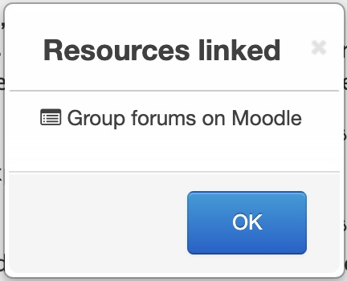
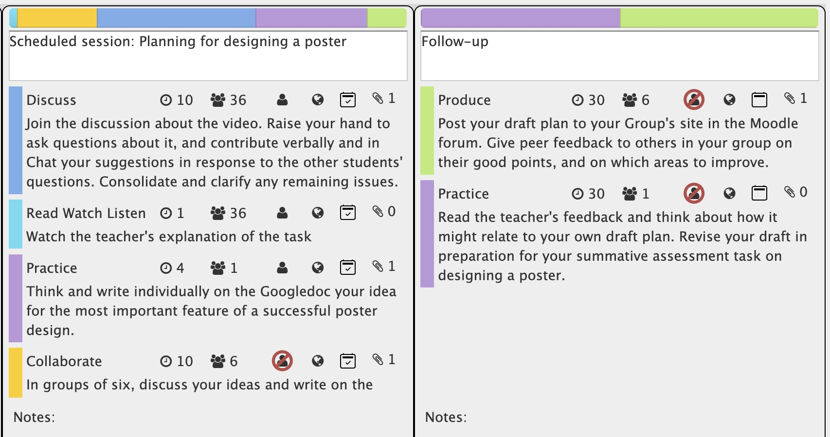
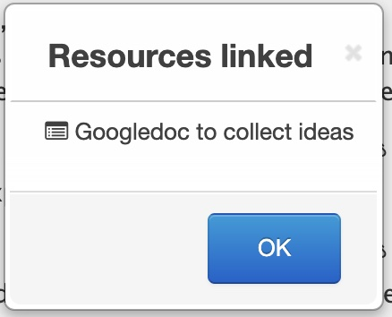
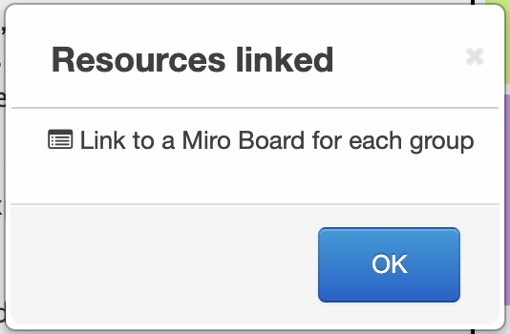
Optimizing digital for learning
Digital tools
For a session on ‘learning how to design a digital poster’ this teacher has used 3 different online tools for discussion and collaboration
Notes:
One important way to optimise a learning design is to embed the most useful digital tools. This is a learning design for a session on learning ‘how to design a digital poster’. The teacher has integrated
A Googledoc so that students can collect and share their ideas for a good design
A Miro Board where they can share the designs each group makes. And then
A group forum in their VLE, in this case Moodle, so they can present their draft ideas, discuss each other drafts, and the teacher can give feedback on all of them.
OK

Slide 21
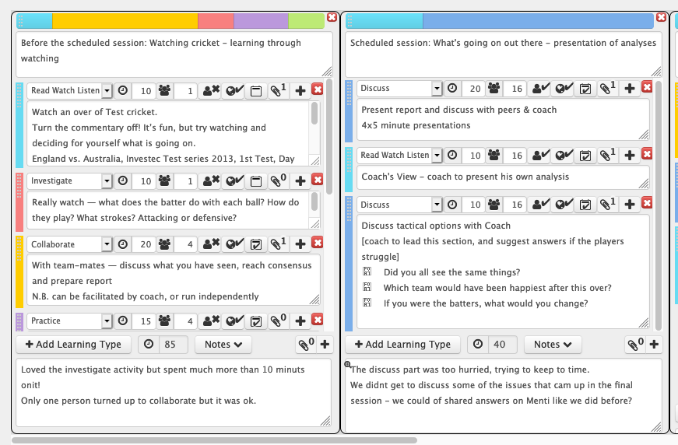
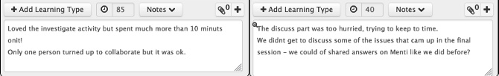
Evaluating a learning design – by students
Student evaluation
Share your design post hoc with students.
Invite them to comment in the Notes.
Collect their comments in a Googledoc.
Notes:
You can also use your learning design for evaluation, either by other teachers, or by your students. For the student evaluation it's useful to suggest they comment on each panel of your design. These two panels show part of the design, and the student feedback is in the Notes at the bottom.
This is a design intended to help sports science students in learning to observe the actions of batsmen. The Investigate activity in the first panel asks them to watch the detail of the stroke in the video.
- This student has commented that they spent much longer than the allotted 10 mins, and also that the Collaborate activity did not have the full group attending. They also have comments on the second panel about needing more time to discuss.
Comments like this could come from either students or the colleagues in your teaching team. This type of evaluation tends to give very specific advice on each part of your design, which can be very helpful.

Slide 22
Supporting teachers innovating
Designing activities for learning
To focus on what students need to do
Building on what you know
Use and Adapt conventional methods
Articulating your design of what students DO
Clarify what and how students will learn
Analyzing a learning design
Feedback that helps you analyse the design
Optimizing digital methods for learning
The digital tools that can enhance each activity
Evaluating learning designs
Detailed feedback from peers and students
Designing activities for learning
to do
Building on what you know
Use and Adapt conventional methods
Articulating your design of what students DO
The digital tools that can enhance each activity
Analyzing a learning design
Feedback that helps you analyse the design
Optimizing digital methods for learning
Shareable designs enable teachers to in
Evaluating learning designs
rk of others
Notes:
So this is how learning design supports teachers innovating:
Designing activities for learning
To focus on what students need to do
Building on what you know
Use and Adapt conventional methods
Articulating your design ideas
Clarify what and how students will learn
Analyzing a learning design
Feedback that helps you analyse the design
Optimizing digital methods for learning
The digital tools that can enhance each activity
Evaluating learning designs
Criteria for testing with peers and students
But now, how do teachers collaborate to innovate? It’s not feasible for each teacher to shoulder the whole burden of all these different kinds of pedagogy we’ve been discussing.
CHECK QUESTIONS?

Slide 23
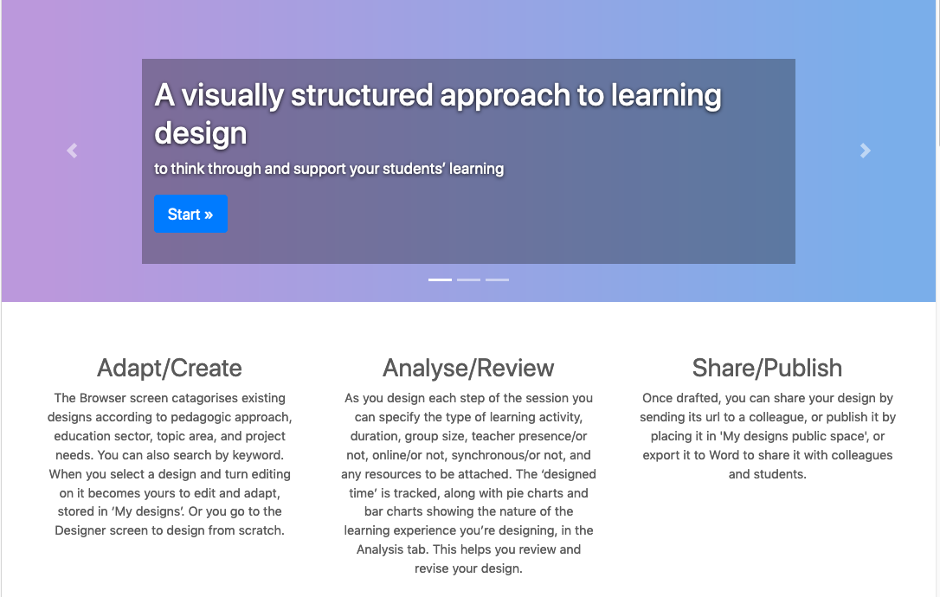
Collaborating to innovate – How can we do it?
The Learning Designer tool helps teachers think through their pedagogies for conventional, digital and online learning
Notes:
Collaborating to innovate – How can we do it?
Well, the Learning Designer tool helps teachers think through their pedagogies for conventional, digital and online learning, and helps them articulate how they intend to support their students’ learning. They can use the tool to then share their designs with colleagues, and then also make them public for all teachers to see their way of using digital methods.
But how do they work in collaboration?

Slide 24
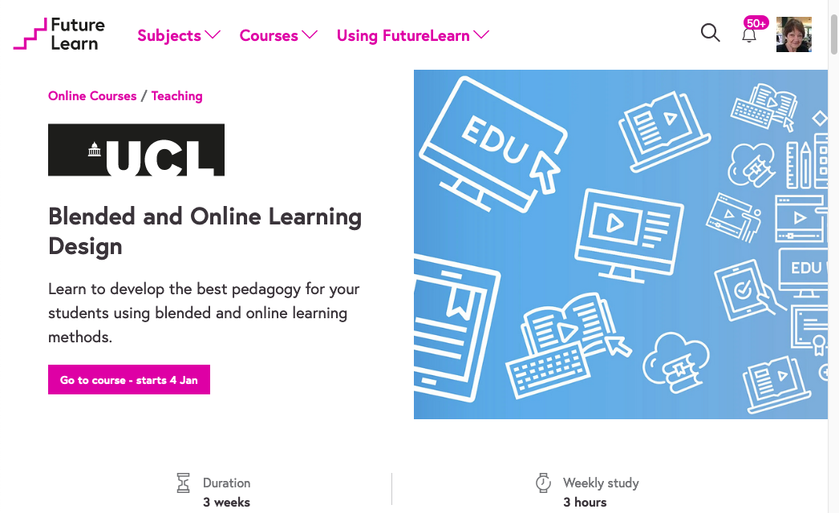
Large-scale online course to orchestrate collaborative knowledge development by education professionals
https://bit.ly/BOLDcourse
>12,000 teachers actively participating
Notes:
This is a course that’s running now on the FutureLearn platform. It’s a MOOC, a massive open online course. It’s on ‘Blended and Online Learning Design’, and is free and open to all teachers, in all sectors and subject areas.
You can enrol at any time https://bit.ly/BOLDcourse
The course exercises are based on using the Learning Designer, for teachers to explore and exchange ideas for good ways of supporting their learners.
Here’s a taste of how we can use this platform for teachers to collaborate and develop new digital pedagogies.

Slide 25
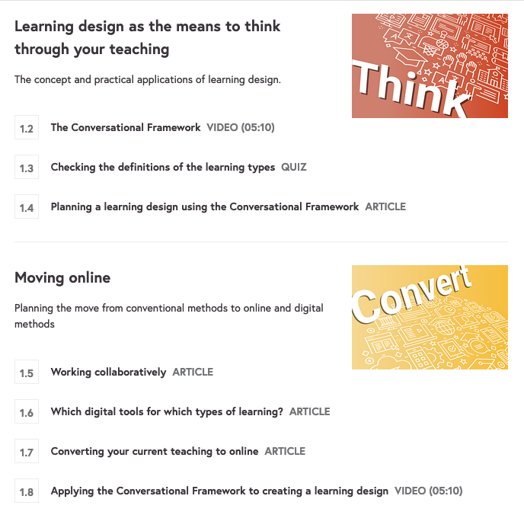
Week 1: Rethinking your current teaching
Builds on current teaching
Introduces the Conversational Framework for the underpinning pedagogic principles
Introduces the Learning Designer as the means to take these into your new digital practices
Prepares the groundwork for collaboration
Notes:
In Week 1 the participants go through the basics of the CF, then work through exercises to use the theory to decide on how to take a f2f classroom session online. It introduces the LDer and shows how this can be used for both designing new blended learning sessions, and how the teaching community can work together to collaborate on discovering these new methods.

Slide 26
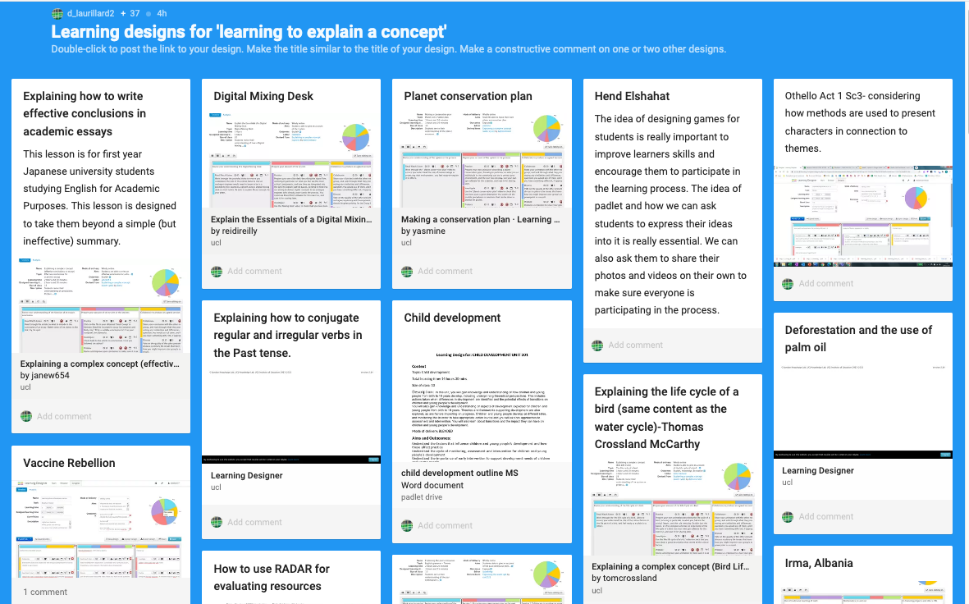
Step 2.3: Designs for the learning outcome ‘to explain a concept'
Exercise to compare two versions of a learning design
  Generic ‘to explain a concept’
  Specific ‘to explain the water cycle (physics)
Adapt your own learning design from this example
Share on the Padlet wall
Notes:
In this Step in Week 2 they look at a learning design aiming to help students learn to explain a complex concept. The example originated with a physics teacher for learning about the water cycle. The participants have to adapt that design to their own topic and share it on a Padlet wall.
And look at the range of concepts they adapt it to... And naturally they adapt the pedagogy too, as you can see from the different pie-charts.
Here is the original design for the complex concept of the water cycle in physics, for school students, several panes, over 3 hours, beginning with an activity to revise their understanding by watching a video, then preparing their own account of the system, and then collaborating to produce an agreed account. So most of the text there is a description of pedagogy. The topic may change, but the pedagogy is what we can share across subject areas.
This is the beginning of sharing to collaborate.

Slide 27
Comparing an original and adapted learning design
Notes:
And here is the adaptation of that specific LD to a generic version, but presented in list view instead of the panels
And then an adaptation of that to the new topic of financial statements for college students, just over 2 hours, and fewer sections, but similar pedagogy. The adaptation can build on the original, but change the pedagogic features to fit the new context as well.

Slide 28
Comparing an original and adapted learning design
Water Cycle
3h
Financial
2h 15
Acquisition Inquiry Practice Discussion Collaboration Production
Acquisition Inquiry Practice Discussion Collaboration Production
Online/Not Teacher Present/Not Synch/Asynch
Online/Not Teacher Present/Not Synch/Asynch
Whole class Group One
Whole class Group One
Notes:
And then comparing the original analysis with
- the new version we can see the total duration has got shorter, and the teacher has changed the overall distribution of the learning types, as well as the other features.

Slide 29
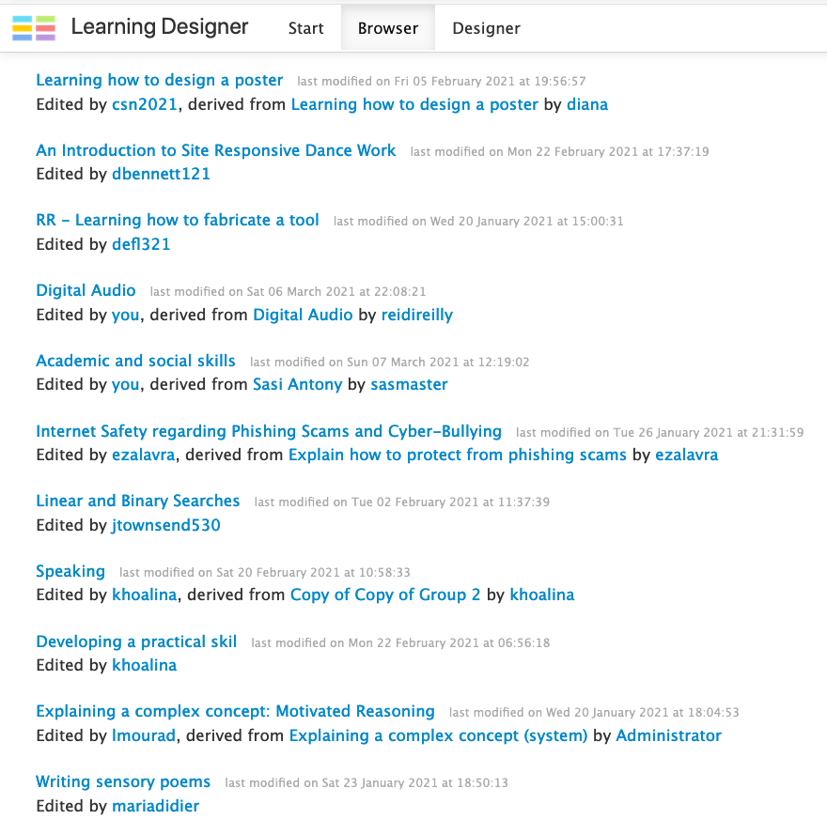
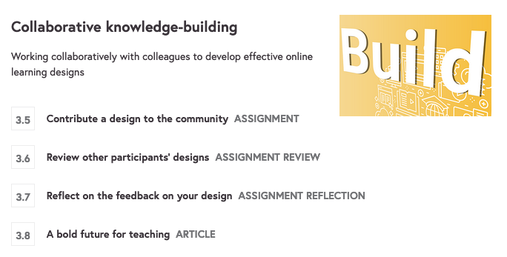
Week 3 Activity 3: Collaborative knowledge-building
“the democratization of innovative capacity”
(Scardamalia & Bereiter, 2010:11)
Peer sharing and review:
Building a collaborative community of teaching and learning innovation
“to improve the connection between teaching, learning and technology, bringing together the leading experts in higher education, with the goal of improving and enabling quality technological academic instruction”
MEITAL aims
Notes:
Then in Week 3 they go on to use a peer review exercise to share and critique each other’s designs, beginning now to build a collaborative community of teaching and learning innovation
Here is an extract from the Browser screen showing some of the designs contributed by teachers participating in that course. There is quite a range on offer, and as they increase, we copy them into additional browser spaces, collected by age group or subject matter. This process of contributing, peer review, revising and then sharing your design, is how we gradually build teachers’ collective design knowledge of how to design design pedagogies.
This is exactly how the MEITAL Conference describes its aims.
- And I think what we’re all talking about here is what Marlene Scardamalia and Carl Bereiter were alluding to in their reference to “the democratization of innovative capacity”. But this is not just for students… it's for teachers as well. The week ends with a bold future for teaching, where it's the teachers who are doing the collaborative knowledge building for digital pedagogy.

Slide 30
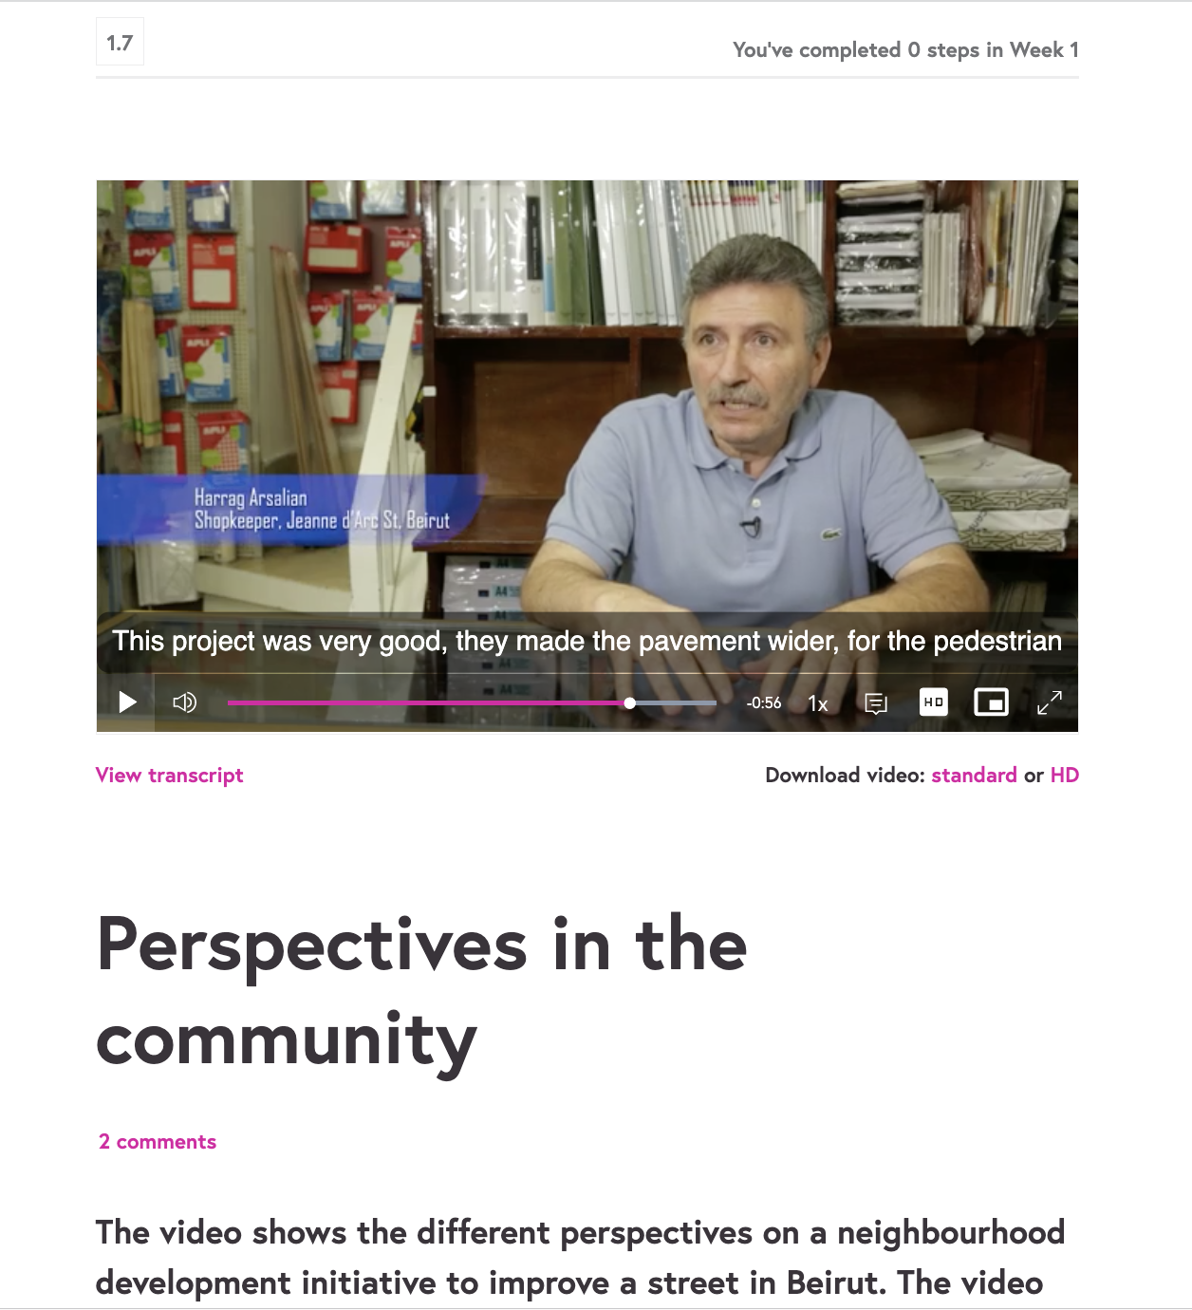
A ‘Co-design’ Theory of Change for professionals innovating
To achieve engagement with the intended audience, inclusion of partner knowledges, and long-term impact, a collaborative approach is needed from the start.
Stage | Professional Development process
Engage | Collaboration with NGOs to demonstrate CBR practices in the CoMOOC
Develop | Collaboration with professionals to develop the CoMOOC
Extend | Professionals join CoMOOC and contribute tested local solutions to the community
Embed | Activities support participants creating their own local workshops and projects
Sustain | Collaboration with sector actors to take responsibility for maintaining and updating the course and the shared repositories
Notes:
That’s the collaborative model for the CoMOOC itself, but to engage with the external context of a wide range of potential stakeholders, and a long term broadening of impact, we also need to articulate
- our Theory of Change to:
Engage the professionals - in our case, civil servants or NGO staff, for you it would be academics and learning designers
Select some who can help us develop the CoMOOC needed
Extend the testing and sharing of solutions via a MOOC platform like the one I just demonstrated
Embed the new practices in local contexts, using video case studies and advice on running local blended learning workshops using the MOOC resources
Sustain the whole process through new stakeholders
where each stage is an essential part of an iterative process of feedback loops to continue learning from the professionals who participate.
This is how we conduct one specific but practical way of addressing the many problems and challenges we will be discussing at this conference.

Slide 31
Digital pedagogies could help with some of the big challenges for teaching and learning
Reduce teacher workload AND improve student learning?
Peer review
Vicarious personalized learning
Notes:
Why are digital pedagogies important for teaching and learning? We’re only just beginning to clarify the reasons why we need digital technologies and what they can do for teachers and students. They make most impact where the challenges are greatest. I want to end with an example of a big challenge: is it feasible to use digital methods to reduce the demands on teacher workload while also improving student learning? I want to look at two examples of how we might adapt classic pedagogies to new digital learning designs to help with this.

Slide 32
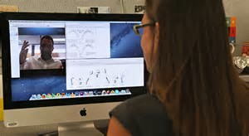
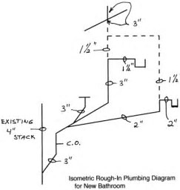
Peer review
Students have more opportunities to collaborate online than is usually feasible in person – if they have the right technology
Notes:
Learning from other students can be a significant life skill for your students, and yet peer learning is a significant pedagogy that is much underrated. Let’s look at this in detail.

Slide 33
Engaging students in active learning: Online peer review
A simpler version of ‘peer instruction’
Teacher sets assignment and rubric on VLE
Each student
produces own answer,
reviews 2 peers’ answers,
revises own after receiving 2 reviews and doing 2 reviews,
submits improved draft for assignment
Teacher has improved assignments to grade, with no additional workload
Notes:
Peer Review is an example of a valuable conventional pedagogy that can work equally well for students online, and yet not add too much to the teacher's workload.
The task is to review and give feedback on each other’s work according to a rubric, and then use this experience, and the feedback they receive, to create an improved assignment for the teacher to mark.
This can be run entirely online, using your VLE.
- Each student
creates a first draft of an assignment using the rubric (30 mins)
reviews 2 students’ drafts against the rubric (20 mins)
uses the 2 feedback reviews to revise their own answer (10 mins)
and submits it to the teacher (30 mins)
- The teacher just provides the rubric and sets up the activity, but they also receive much better assignments to grade.
This is quite a generic pedagogy that teachers have explored, tested and published in the Learning Designer as a shareable teaching idea, and it could be used in any subject area, for any type of assignment.

Slide 34
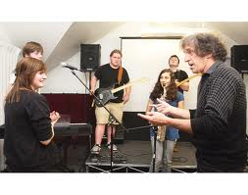
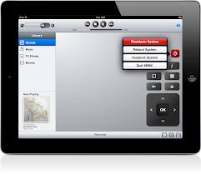
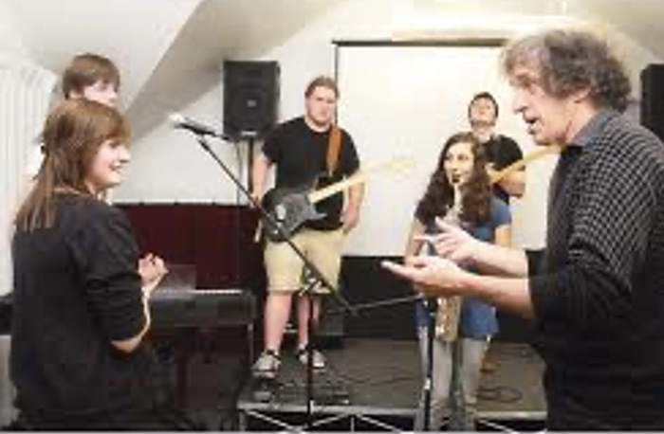
Taking the tutor group online: the vicarious masterclass
The masterclass for 5 students: Time 50 mins
Questions and guidance for 5 students
Each student receives personal feedback, and sees feedback for 4 others
Teacher provides personal feedback for 5 students
The vicarious online masterclass: Time 50 mins
Video of the tutor group is on VLE for all students
Students have no personal feedback, see feedback for 5
Teacher provides personal feedback for 5 students, but all students benefit from forensically detailed guidance
Notes:
The tutor group will be familiar as a conventional teaching method for small groups who need to practice a skill or procedure in detail, and where each learner needs detailed feedback, such as a music class, or life drawing, or a science experiment, or language learning…
The simplest form might be a 50-minute class, say, of 5 students, who take it in turns to demonstrate what they can do, while the other 4 students hear and watch the feedback from the teacher. So each one has personal 1-1 feedback for about 10 mins, and watches feedback on the 4 other student performances for about 30 minutes.
It’s a good method, but providing this to all students is very time-consuming.
- An alternative is a blended version, a kind of Vicarious Masterclass, also run entirely online.
- One small group, say 5 students again, is filmed having detailed individual feedback from the teacher as in the f2f version.
The video of the class can then be watched online by all the other students in the class, who have the same vicarious
experience of teacher feedback as the 4 students watching in the group. They do not receive individual feedback, but they do have the same experience of feedback to other students that the students in the small group have. And over a period of a few weeks it should be possible for all students to experience at least some 1-1 feedback.
- But here, the teacher is providing feedback to only one small group, while all the students benefit from watching that forensically detailed individual feedback in the video.

Slide 35
Reduce teacher workload and
Improve student learning?
Guide students through their online work as individuals and with each other
→ improves their learning for often little additional teacher time
Notes:
The point is that guiding students through their online work as individuals and with each other improves their learning for often little additional teacher time

Slide 36
A generic learning design for peer review
Notes:
And again, there is a generic version of this learning design in the LDer browser that you could adopt and adapt for your own students,
- in any subject area. Again, most of the guidance to students is about pedagogy, not about the topic, which is all contained in the resources.
- to summarise...

Slide 37
Teachers as collaborative designers of learning
There are many advantages of learning with digital technology
Active learning, meaningful feedback, peer learning, teacher workload
How do we help students learn?
Focus on student learning, activities aimed at outcomes, learning types
A Learning Designer tool enables teachers to innovate
To optimise the blend, articulate your pedagogy, share it to collaborate
They can collaborate to innovate
Using MOOC platforms and the Learning Designer is one possibility
Managing teacher workload is feasible
Digital tools and collaborative learning for students, collaboration among teachers
There are many advantages of learning with digital technology
Active learning, meaningful feedback, peer learning, teacher workload
How do we help students learn
Focus on student learning, activities for outcomes, learning types, criteria
A Learning Designer tool enables teachers to innovate
To optimise the blend, articulate your pedagogy, share it to collaborate
They can collaborate to innovate
Using MOOC platforms and the Learning Designer is one possibility
Managing teacher workload is feasible
Digital tools and collaborative learning for students, collaborating with teachers
Notes:
This is the a outline rgument for giving teachers this key role in developing digital pedagogy:
The advantages of learning with digital technology?
- Active learning, meaningful feedback, peer learning, teacher workload
How do we help students learn?
- Focus on student learning, activities for outcomes, learning types, criteria
A learning design tool enables teachers to innovate
- By optimising the blend of digital tools for each type of learning, articulating your pedagogy, sharing it to collaborate
Collaborate to innovate: How do we do it?
- Using MOOC platforms and the Learning Designer is one possibility
Managing teacher workload is feasible
- Digital tools and collaborative learning for students, as well as collaboration among teachers

Slide 38
Teachers as collaborative designers of digital pedagogies
Who will develop the new digital pedagogies?
→ Trust the teachers to do this development
What do students need from EdTech?
→ More active learning
What do teachers need?
Support to do innovate collaboratively
→ The time to do it
Who will develop the new digital pedagogies?
→ Trust the teachers to do this development
What do students need from EdTech?
→ More active and social learning
What do teachers need?
Support to innovate collaboratively
→ The time to do it
Coming soon…
Notes:
So to summarise the main points I’ve been making
Who will develop the new digital pedagogies?
- Trust the teachers to do this development
What do students need from EdTech?
- More active l and social earning
What do teachers need?
- Support to innovate collaboratively
and critically, the time to do it
Note new book...
Now I’d like to discuss with you what you think of these ideas?

