Slide 1
When EI meets AI שילוב AI בהשכלה הגבוהה היבטים אתיים
21
כנס מיט"ל ה-21
מאיר קומר komar@g.jct.ac.il –
המרכז האקדמי לב
June 2023 תמוז תשפ"ג ذو الحجة 2023

Slide 2
מה הן 3 הבעיות האתיות המרכזיות הקשורות ל-AI?

Slide 3
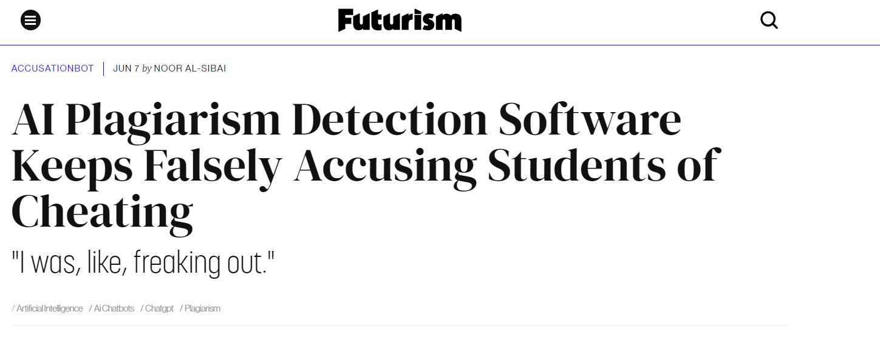

Slide 4
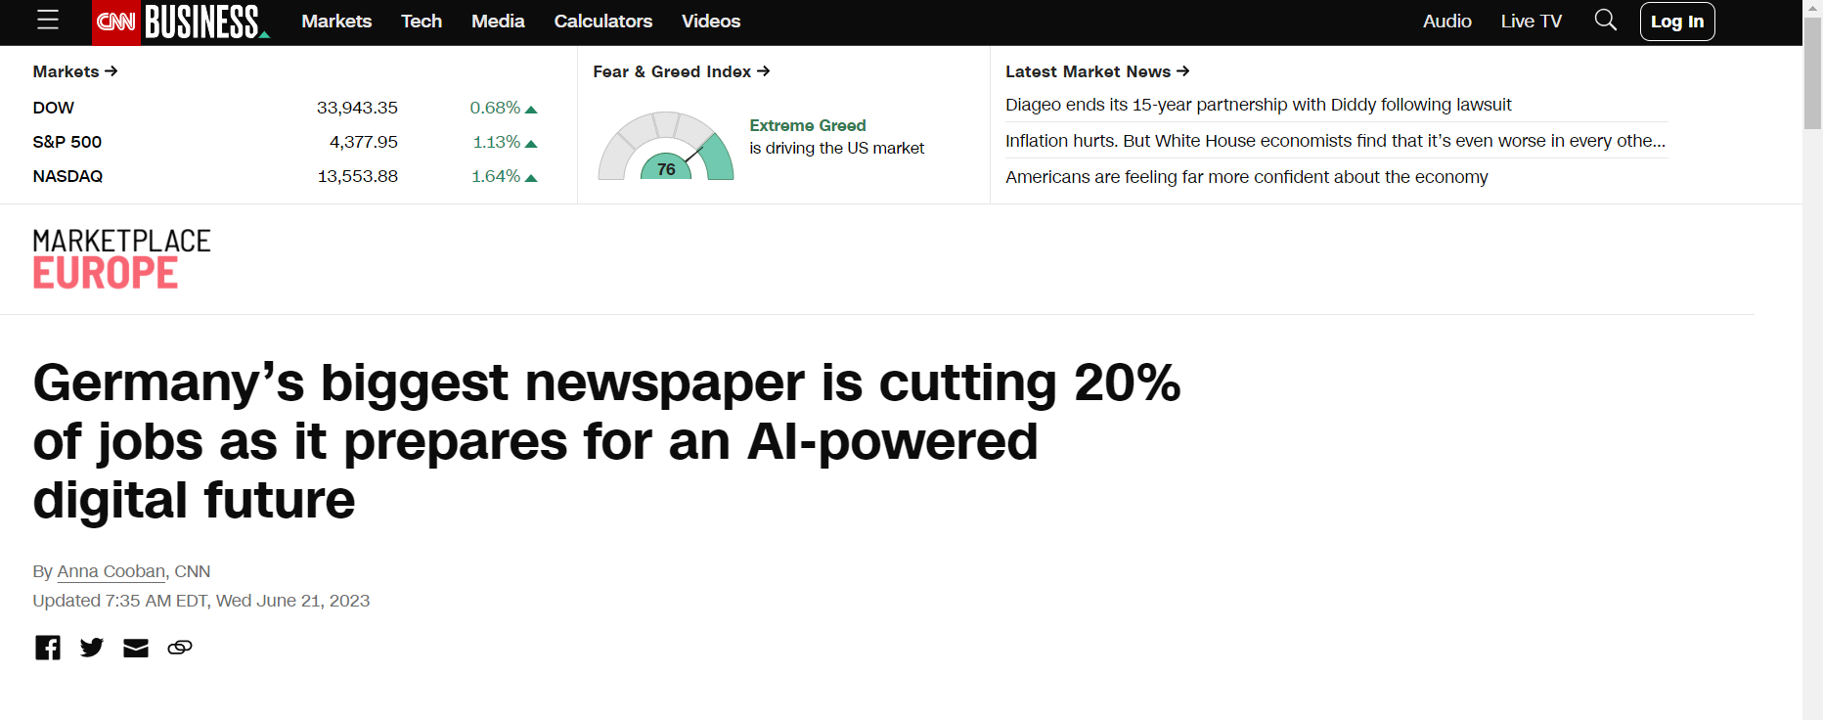

Slide 5
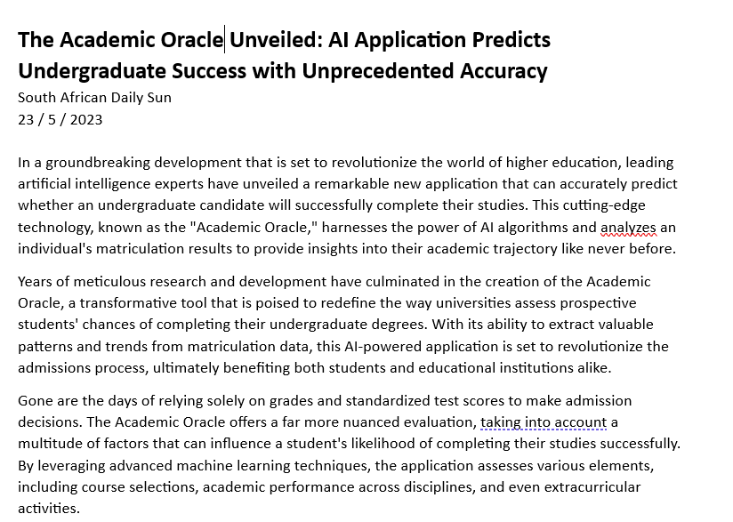

Slide 6
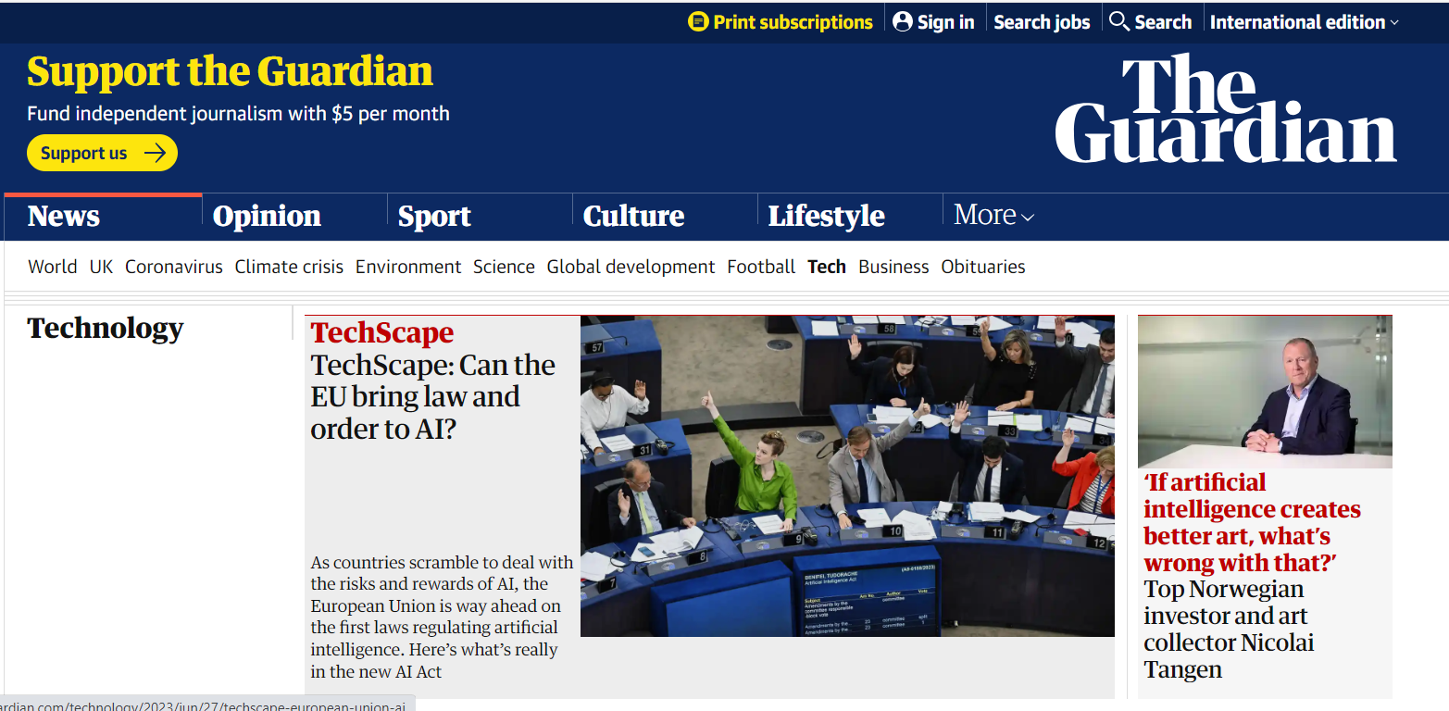
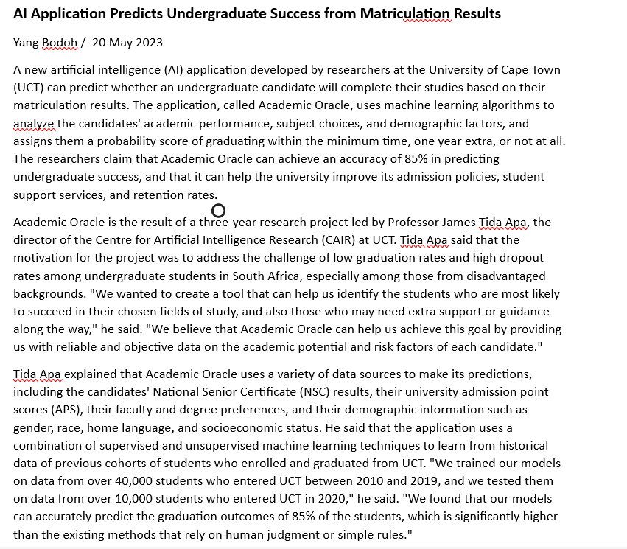
AI Application Predicts Undergraduate Success from Matriculation Results
Yang Bodoh/ 20 May 2023

Slide 7
AI ethics is a set of moral principles to guide both the development and the use of AI technologies
Ethical AI = AI that performs and follows legal, moral, and ethical standards generally accepted by society

Slide 8
What are some of the ethical issues?
Bias and discrimination
Accountability/ responsibility
Regulation
Social implications
Job displacement
Digital divide
Plagiarism copyright
Developer issues
Transparency
Privacy and security
Human oversight

Slide 9
What is the Role of the centers for Academic Excellence?
E³
Educate
Engage
Empower
Notes:
הכרת הכלי Educate the educators on the basic concepts and principles of AI, such as how it works, what it can and cannot do, and what are the potential benefits and risks of using it in education.
הפעל אותםEngage the educators in ethical discussions and decision-making processes regarding the design, development, and deployment of AI-driven apps for education. This could involve creating ethical guidelines or frameworks for AIED, conducting ethical impact assessments, and involving stakeholders such as students, teachers, technology developers, policymakers, and institutional decision-makers.
להעציםEmpower- educators to use AI-driven apps for education in a responsible and ethical manner, such as by ensuring data protection and privacy, avoiding bias and discrimination, ensuring trust and transparency of algorithms, and respecting human agency and autonomy.

Slide 10
Teachers must have the knowledge to understand, justify, and evaluate results by AI-based tools

Slide 11
What do we (institutes of higher education) need to consider?
Every graduate must be exposed in general to the ethical issues of AI technologies as well as the specific issues in their field of knowledge
Updating and expanding the lecturers' regulations and the students' regulations to include reference to the use of AI tools
Updating and expanding the institution's organizational work procedures to include reference to the use of AI
Align institutional policy with national and global standards ( not there yet but down the road…)
With the growing use of AI, realigning the institutional workforce and budgets; investing in cyber security and appropriate IT infrastructure to cater to the growing needs

Slide 12
What do we (institutes of higher education) need to consider?
Creation, by the various stakeholders, of a transparent institutional code of AI ethics
Institutional AI ethics committee Training/expanding scientific committee
A new institutional position - Chief AI Ethics Officer
Director of AI / AI Ethical advisor
Create a template(s) for a course AI usage policy subject to institutional guidelines
Encouraging lecturers to expand on the challenges of AI in relation to professional ethical responsibilities

Slide 13
MATERIALS

Slide 14
מה הן 3 הבעיות האתיות המרכזיות הקשורות ל-AI?

Slide 15
עד כאן מבוא לפתיחת ההקדמה

Slide 16
Transparency
What is the data model based on?
Big Companies – Big Data
Opaque algorithms – Such as ML based on neural networks can be very hard to understand the decision-making process. This could lead to mistrust and lack of accountability.

Slide 17
Accountability
Who is responsible? The AI, the user, the algorithm developer?
Self driving example

Slide 18
Job Displacment
Job displacement at the national and global levels can have a negative effect of people’s self dignity
Employers have a responsibility towards there employees, how is this done in the world of AI?
Can affect disproportionately various populations, such as low-wage workers without the access an/or training to adapt to new types of jobs.
Can cause economic disruption that can effect various levels of populations: communities, regions, states, countries

Slide 19
Privacy and Security
Basic human right ( UN Deceleration of Human Rights)
GDPR, COPPA, OECD AI Principles, UN-Framework for Ethical AI, The EU Artificial Intelligence Act
Facial recognition – China, EU, Israel
Privacy vs personalization
AI can be used to detect security breaks…
Need for enhanced cyber security
The use of language models in education may raise privacy concerns, particularly if student data is being used to train the models

Slide 20
Discrimination
And
Bias
Can reinforce preexisting prejudices and bias
What is the source of the data used to train the model?
Language models are trained on large amounts of data, and if that data is biased, the model will also be biased. This could lead to unfair or inaccurate results.

Slide 21
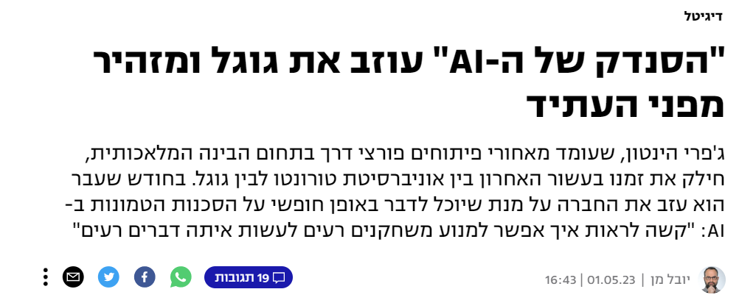
Societal implicatations
Job Displacement
New distribution of wealth
Influencing behaviors and interactions for good and for bad
Emotional manipulations
Increasing the digital divide
Notes:
ML can generate factually incorrect text, media – fakenews, deep fake

Slide 22
Plagiarism
It's crucial to have a clear policy on plagiarism and to educate students and educators on academic integrity while also making sure that the use of GPT and other language models is done thoughtfully with its limitations in mind.
Who is the author?
Who owns the rights?
What is the new plagiarism?
Notes:
כל הנושא של יישומים הבודקים העתקות/מקוריות

Slide 23
Human oversight
Using AI in positions that require empathy, such as, care of the elderly, police, judge, ???
Weaponization of AI
Super Intelligence …

Slide 24
Additional developer issues
Ethical algorithms? Which/whose norms?
https://www.scu.edu/media/ethics-center/technology-ethics/Ethics-Toolkit.pdf
https://developers.google.com/machine-learning/crash-course/fairness/video-lecture
“we deal with the technology, let the lawyers or the ethicists resolve the ethical concerns”

