Slide 1
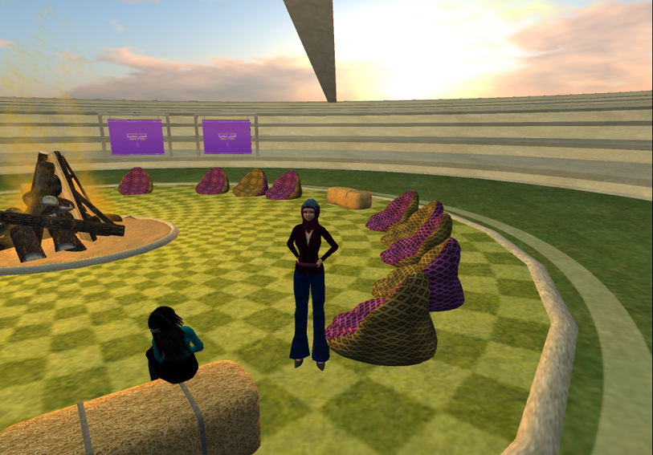
השפעתו של העולם הווירטואלי על כשירות תרבותית: ניתוח פעילויות של סטודנטים ערבים ויהודים במסגרת קורס מקוון בינמכללתי
מירי שינפלד
שירי ליבר-מילוא
הקרן הלאומית למדע
כנס מיטל 2023

Slide 2
Online collaborative learning & Cultural Competence
In recent years, the use of online projects was found to be a useful tool for:
Collaborative learning
Lower stereotypes
Contribute to intercultural competence
Prof. Miri Shonfeld, Dr. Shiri lieber-Milo

Slide 3
Virtual Worlds advantages
Enhancement of students’ motivation and engagement.
Facilitating collaboration.
Providing learning opportunities unavailable in other learning environment.
Increase the sense of self as a learner and a creator.
Prof. Miri Shonfeld, Dr. Shiri lieber-Milo

Slide 4
study main objectives
Compare the effects of learning in VW environments to other synchronous environments such as Zoom on CC.
Examine the role of one mediating variable (collaboration learning) and two moderating variables (level of participation in the course and learners' level of technology) on CC.
Prof. Miri Shonfeld, Dr. Shiri lieber-Milo

Slide 5
ONLINE COLLABORATIVE LEARNING
& CULTURAL COMPETENCE
In recent years, the use of online projects was found to be a useful tool for:
Collaborative learning
Lower stereotypes
Contribute to intercultural competence

Slide 6
Notes:
These objectives are depicted in Figure 1 as the relative effect of two kinds of Synchronous Technology – VW on the one hand and Virtual Communication through Zoom (VC-Zoom) on the other, on CC. CC is assessed by an adaptation of Deardorff’s (2006) defining statements to the Israeli context. Collaborative learning mediates the effect of Synchronous Technology (VW/VC) on Cultural Competence. Participation level and Technology level are depicted as moderators in the relationship between VW/VC and CC

Slide 7
Research population
Pre-service education students, mostly women, from both Jewish and Arab ethnicities.
Average age 30
A third group is drawn from other courses with no online instruction in the same colleges.
Prof. Miri Shonfeld, Dr. Shiri lieber-Milo

Slide 8
Course content, methods of delivery & assessment
The syllabus for the course includes:
- Theoretical background of innovative educational pedagogy.
Relevant research in the field,
Digital tools
Online classroom management.
Principles of collaborative learning.
Prof. Miri Shonfeld, Dr. Shiri lieber-Milo

Slide 9
The course for both VW and VC/Zoom environments comprised of eight units in 24 sessions.
Students were divided into small groups (N=6) & assigned to rooms to work as a team.
Students collaborated weekly in their small to complete tasks for each unit.
Every third week, they meted synchronously (VW or VC/Zoom). All sessions were online.
Course content, methods of delivery and assessment
Prof. Miri Shonfeld, Dr. Shiri lieber-Milo
Notes:
- חלק 4Thus, the VW and VC/Zoom courses differ only for the 8 synchronous sessions.

Slide 10
Data collection
First survey
Second Survey
Semi-structure interviews
Notes:
Cultural competence questionnaire (15 items). Adapted version of Deardorff's (2006) CC definitions, administered three times (see Timeline of activities).
Collaboration questionnaire (12 items) used in Magen and Shonfeld (2018)
Technology level questionnaire (18 items Goldstein's (2017) technology questionnaire
Participation level collected from the site analytics (Moodle, Zoom and VW)
Semi-structured interviews with 20 students (N=20, 5 students from each cultural background) will be conducted at the end of Stage 3 in order to attain deeper understanding of the VW effect.

Slide 11
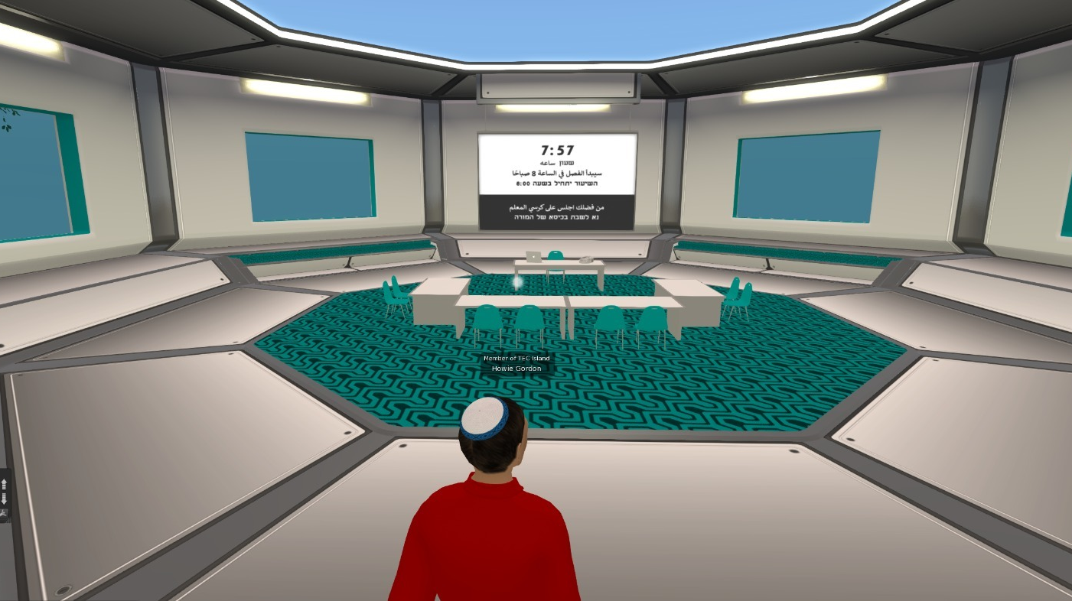

Slide 12
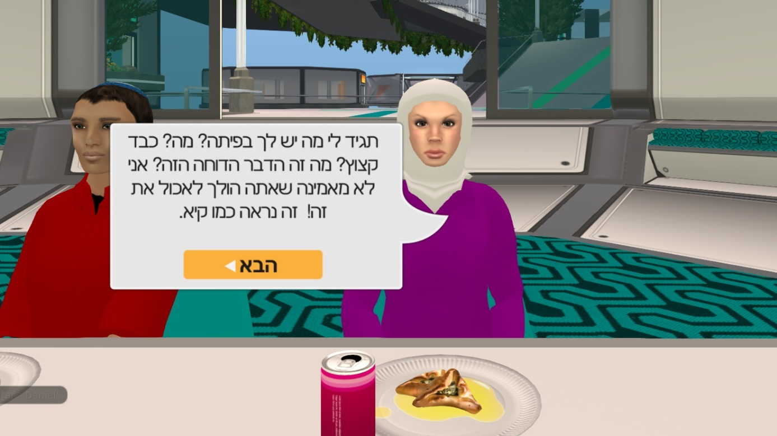

Slide 13
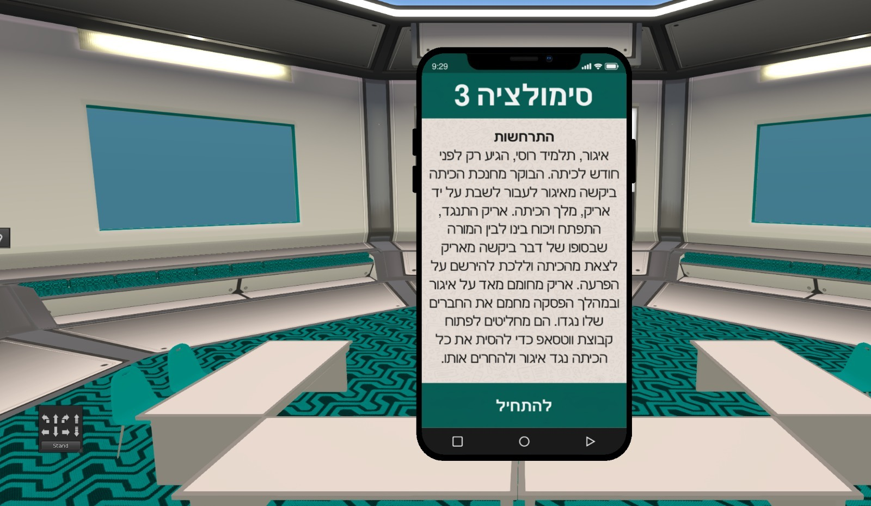

Slide 14
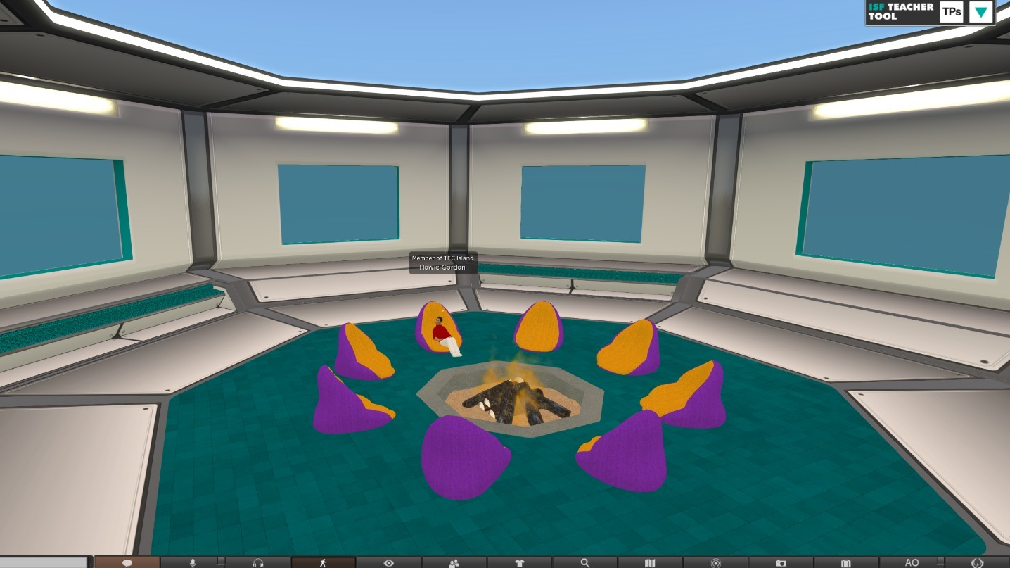

Slide 15
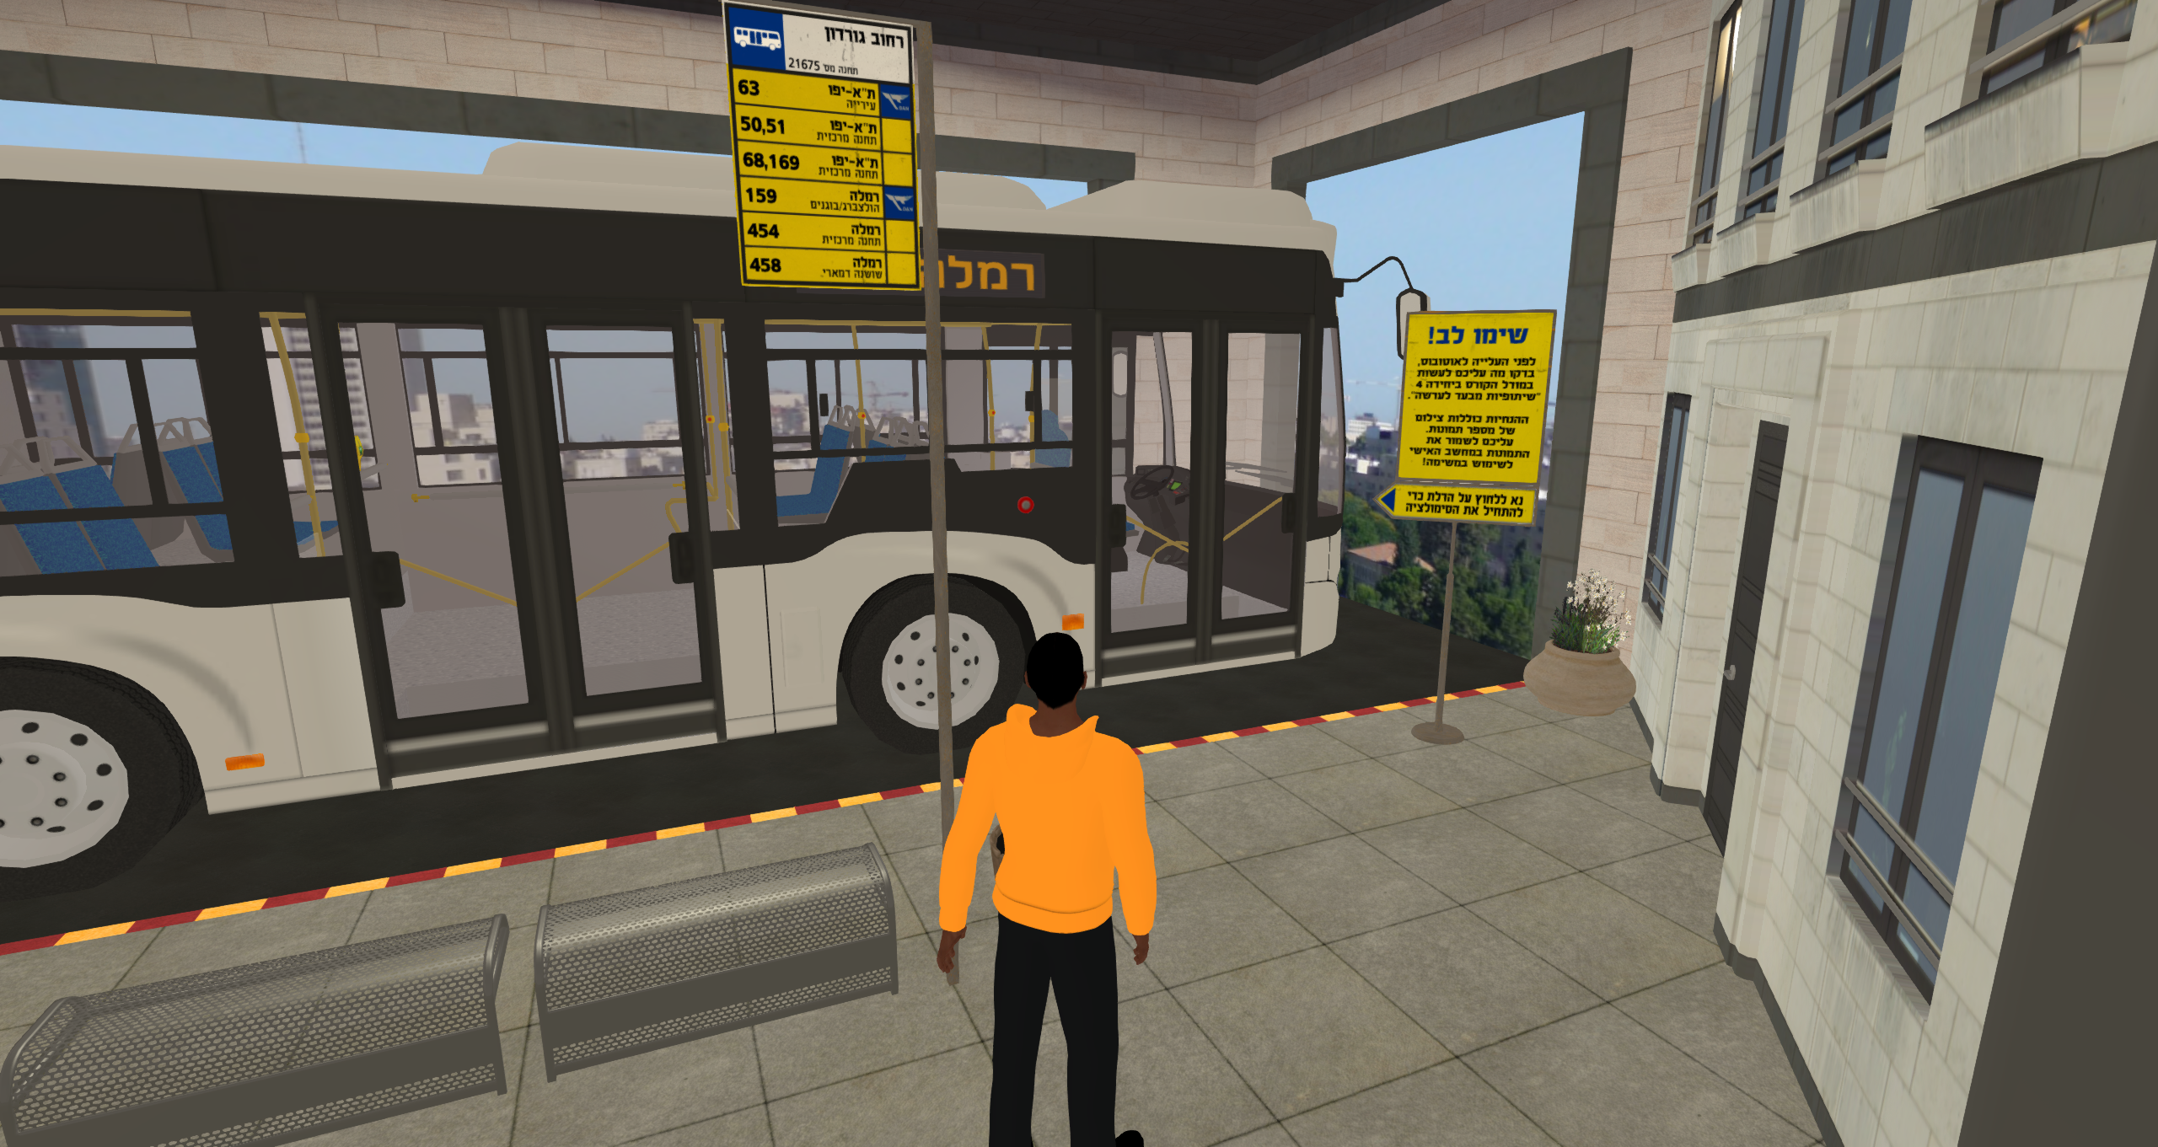
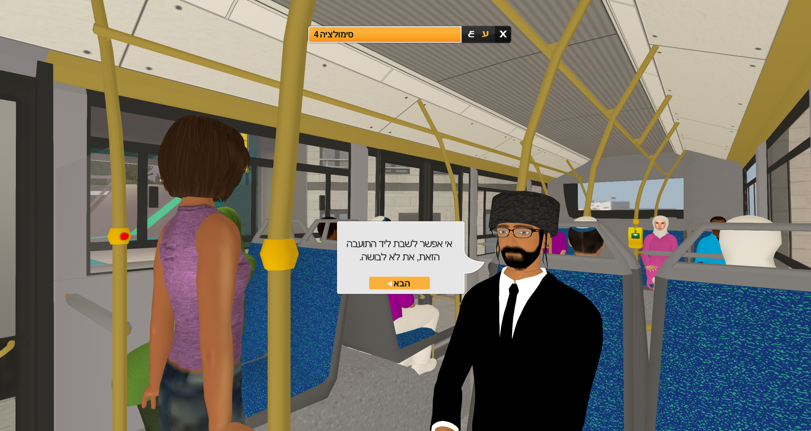
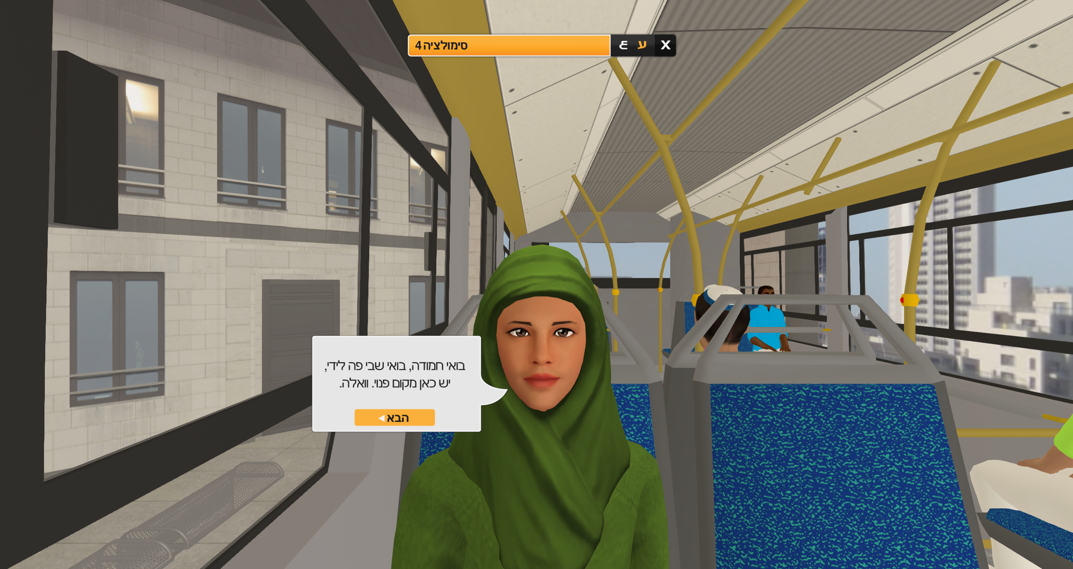
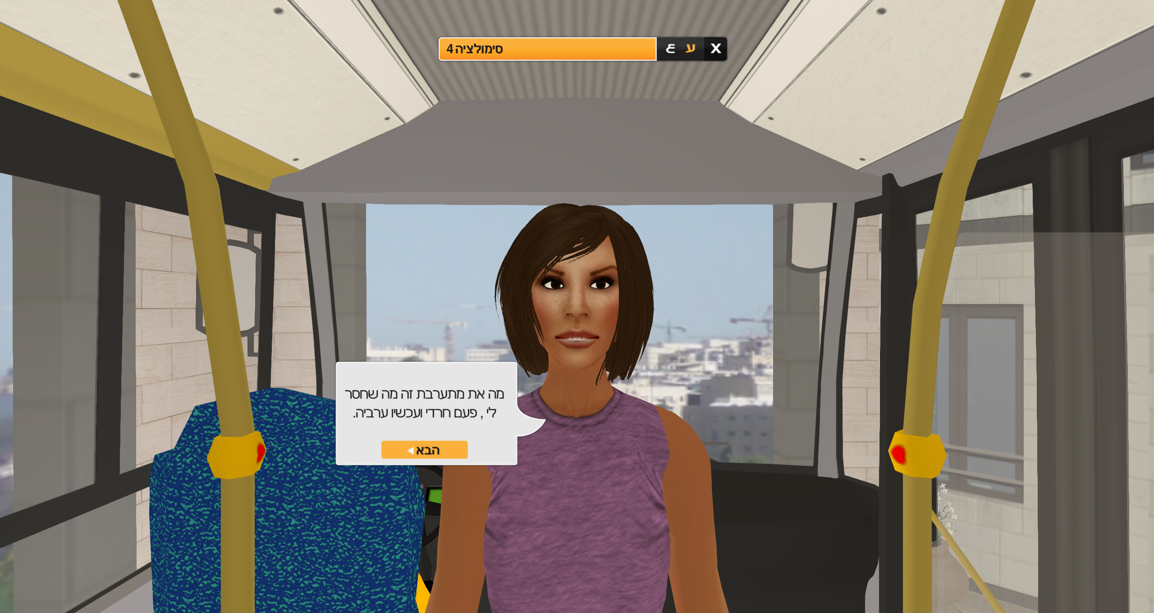
Simulation in the Bus

Slide 16
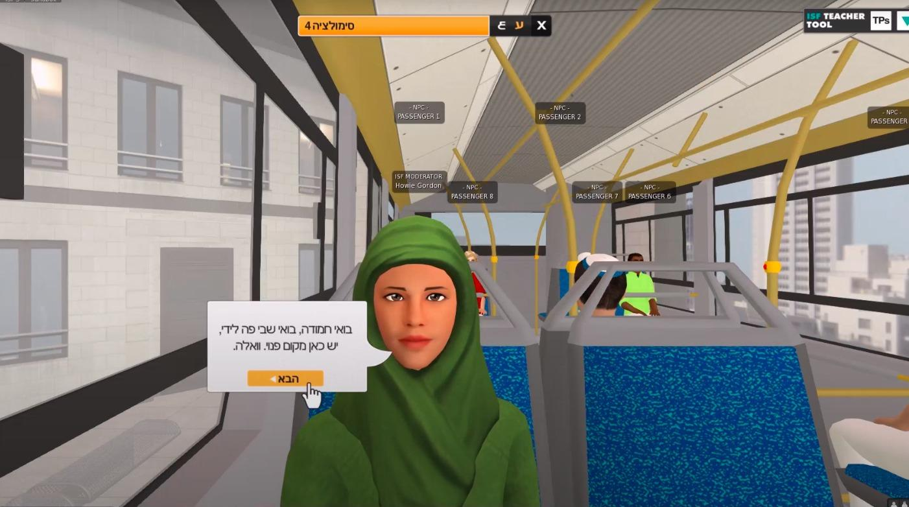
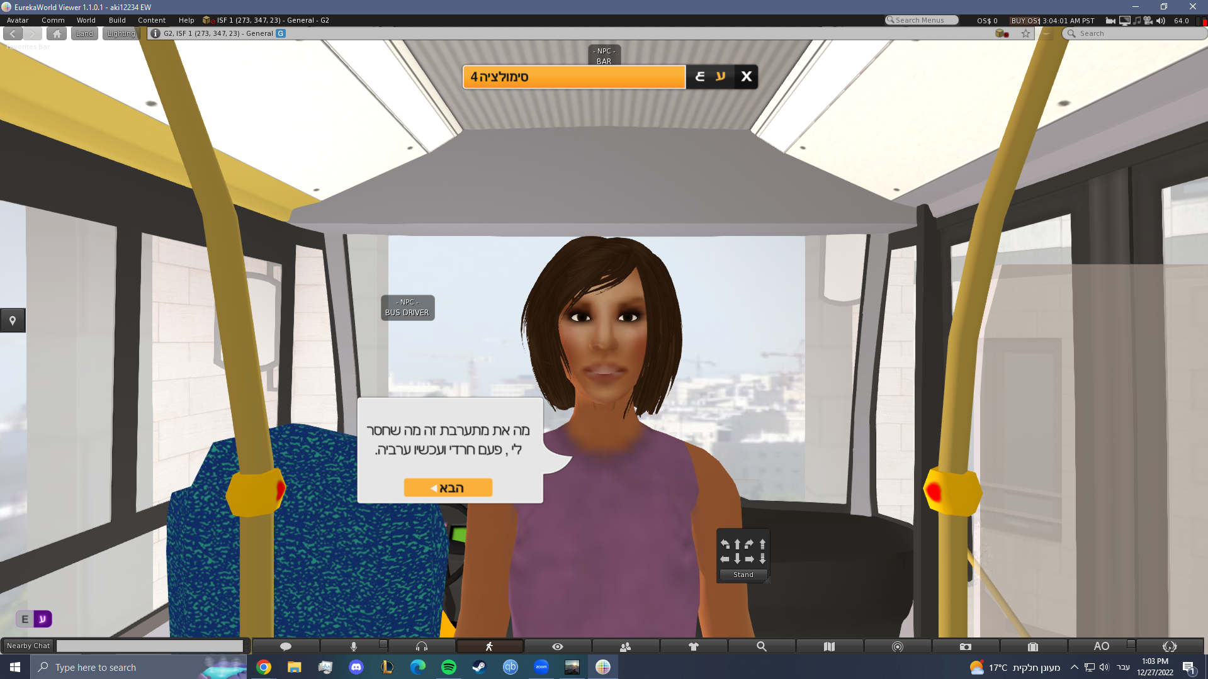

Slide 19
Interviews- 20 semi-structured interviews/ Orthodox Jews, secular Jews, and Muslim Arabs
Those who used the VW in the course reported a more immersive experience, which enabled them to interact with others in real-time and work together in a virtual environment.
Some participants faced challenges in navigating their avatars and dealing with technical issues such as slow internet speeds, which affected their experience with the VW.

Slide 20
Results
Participants who viewed simulations via Zoom during the course found it easier to use but felt that the lack of visual cues and inability to physically interact with other team members in real-time limited the simulation's realism.
Both virtual world and Zoom platforms have the potential to promote cross-cultural understanding and enhance cultural competence among individuals from diverse cultural backgrounds. However, the virtual world platform provided a more immersive experience, while Zoom was more straightforward to use.

Slide 21
THANK YOU!
(הקרן לאומית למדע ISF)
Prof. Miri Shonfeld, Dr. Shiri lieber-Milo

Slide 22
Cultural competence
Three constructs are central to many models of CC: knowledge, attitudes and skills.
Knowledge involves cultural self-awareness, deep cultural knowledge, and sociolinguistic awareness.
Attitudes include respect (valuing other cultures), openness (withholding judgment) and curiosity (tolerating ambiguity).
Skills involve listening, observing, evaluating, analyzing interpreting, and relating. These constructs have been shown to improve following intercultural experience. The questionnaire used in this study is adapted from Deardorff’s (2006) table.
CC is a steppingstone in avoiding misconceptions about others, that it contributes to lowering anxiety and suspicions regarding others, and that it might lead to diminishing cross-cultural conflicts. This last point is of vital importance to our research, which attempts to contribute to the educational literature on CC in a setting with intercultural contact among Arabs and Jews in the Israeli context.
Prof. Miri Shonfeld, Dr. Shiri lieber-Milo

