Slide 1
Integrating Virtual Programming Labs in Higher Education: Benefits, Challenges, and Best Practices
21
כנס מיט"ל ה-21
מאיר קומר komar@g.jct.ac.il -
June 2023 תמוז תשפ"ג رذو الحجة 2023

Slide 2
Agenda
What is VPL?
Key Features
Advantages
Similarity
Challenges
Best practices

Slide 3
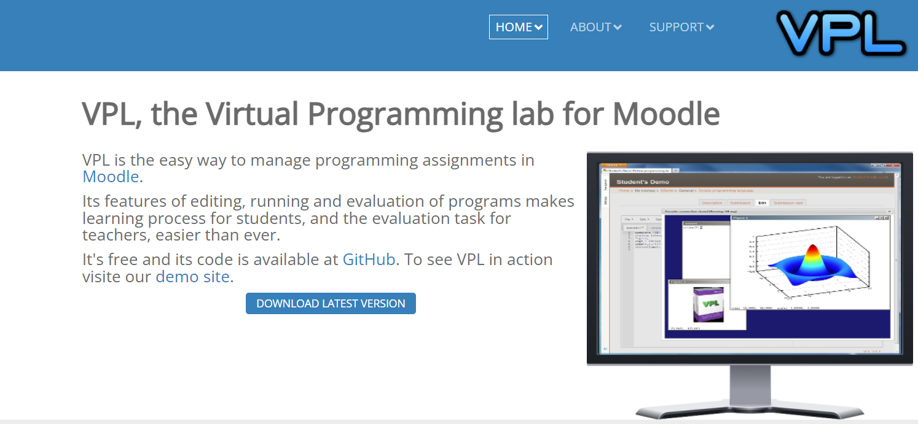
Introduction
Prof. Juan Carlos Rodríguez del Pino
Information Systems Department
Universidad de Las Palmas de Gran Canaria
Notes:
2011 – edulearn 11

Slide 4
Key Features
Basic IDE – with no need for installation or configurations
Integration in Moodle enables:
Easier management of submissions and evaluations
Integration with Moodle gradebook
No need to download, to run and evaluate code
Allows control of assignment environment
Building of test cases and customization of evaluation
Can identify code similarity (plagiarism)

Slide 5
Supported
Languages
ADA | Lisp
Assembler-x86 | Mips
Groovy | Pascal
Scheme | Perl
Shell | Proglog
Verilog | SQL
VHDL

Slide 6
Short Demo

Slide 7
Basic setup of an activity
Create a new VPL activity
Set name and description
Set deadline
Set max # of files that can be uploaded
Set max grade
Save the activity
Set the execution actions (options)

Slide 8
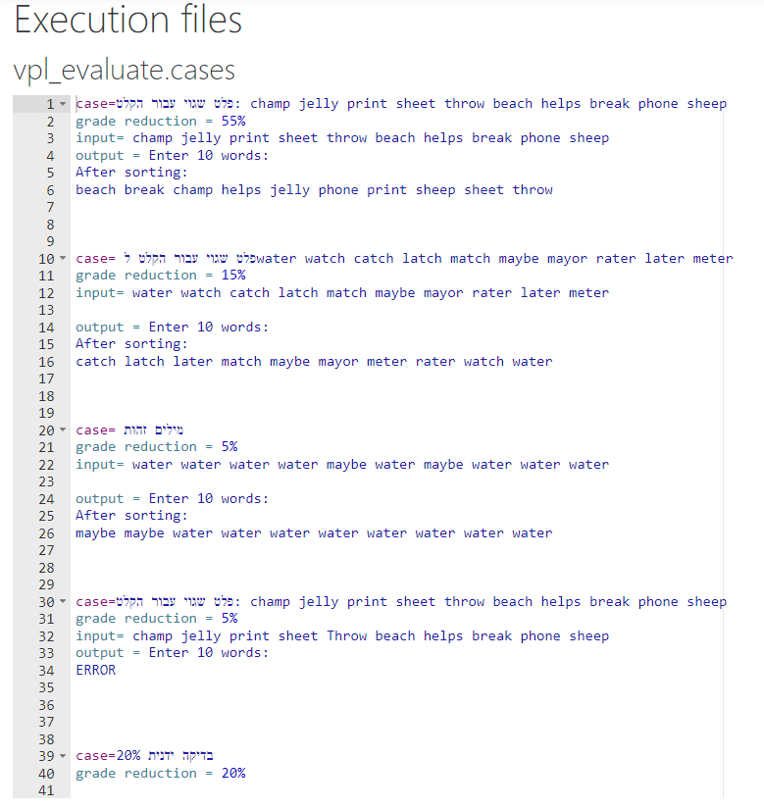
Creating
Test Cases
Format of vpl_evaluate.cases file
"Case= case name": Sets the start and the name of a test case.
"input = text" can span multiple lines. It ends when another statement is entered.
"output = text " can span multiple lines . It ends with another statement. A test case can have multiple outputs statement. There are a few types of outputs: only numbers, text , exact text and regular expressions:
Numbers: only numbers are written. Only numbers are checked out, the rest of the text is ignored. The real numbers are checked with tolerance
Text: Only words are checked, the comparison is case-insensitive and the other characters are ignored.
Exact text : The text is enclosed in double quotes.
Regular Expressions : It begin with / and ends with / and optionally one or several modifiers. Format is similar to JavaScript literal, but POSIX regex is used.
Case = Positive Numbers
"Grade reduction = [ value | percent% ]"
input = 3
4
Grade reduction = 20%
output = 4
5 6.8
output = lemon orange
apple
Basic Input/Output Test Evaluation System (BIOTES)
output = "lemon orange
apple "
output =/^lemon|orange|apple$/i

Slide 9
Creating
Test Cases
Using Failed Messages
"Fail message = message"
Before input
example5Demo
“Program arguments = arg1 arg2 …"
“Expected exit code = number”

Slide 10
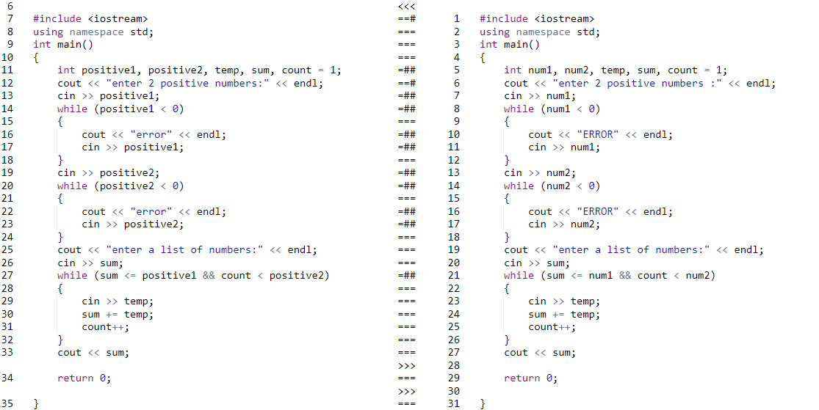
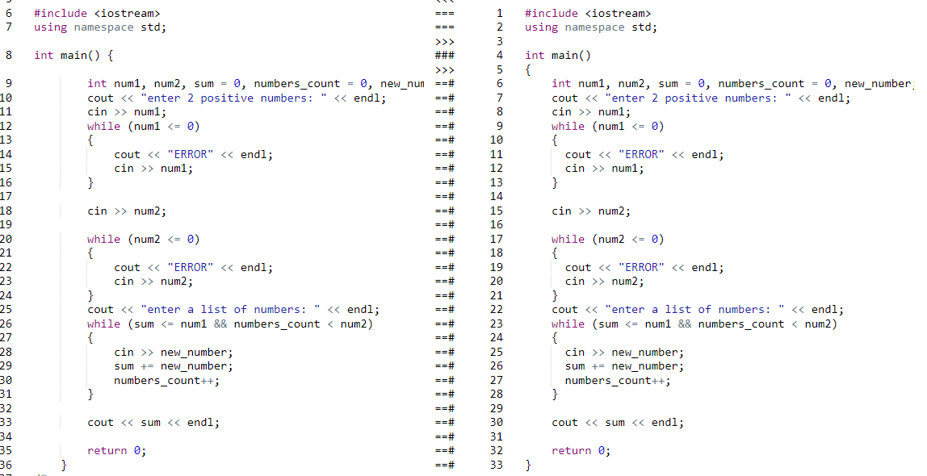
Similarities
Similarities – supported languages
C
C++
C# - partial
Java
JavaScript
Perl
Prolog
Python
Ruby
Scala
Scheme
Shell

Slide 11
Benefits
Simple non-threatening Ide
Helps boost user learning experience
Easy opportunity for repetition
Feedback:
Help develop reflective / self evaluation skills
Useful in digital learning environment
Timely
Enhanced quality
Helps students success
Self-pacing
Flexible/customized
Allows teacher flexibility
Learn to build and use test cases
Notes:
Enhance the quality of feedback provided by instructors:
In traditional programming courses, instructors and TA’s have limited time to provide detailed feedback on individual assignments. With VPL, instructors can provide real-time feedback on student work and easily identify areas where students may need additional help
Improving student engagement:
In traditional programming courses, students may spend a significant amount of time debugging code and troubleshooting errors. VPL provides a more interactive and hands-on learning experience, in which students can write and test code in a virtual environment, allowing for faster feedback and more efficient learning. This can help students stay motivated and engaged in the course.
Success in reaching learning outcomes:
VPL can increase student success by providing a more flexible and personalized learning experience. Students can work at their own pace and receive immediate feedback on their progress. Instructors can also provide customized assignments and resources based on individual student needs. This can help students achieve better learning outcomes and retain more knowledge.

Slide 12
Challenges
Different compilers – different results
- error messages
Does not support binary files
Student frustration

Slide 13
Best Practices
Notes:
80-20 – first semester

Slide 14
Learning Outcomes of the session:
By the end of the workshop the participants will:
Learn how to create and manage VPL activities
How to set up grading and assessment and provide effective feedback to students.
Explore how VPL can be integrated with other Moodle features (for example, the quiz activity) and plugins to enhance learning.
Will discuss challenges and best practices for using VPL in Moodle.
Will have a solid understanding of VPL and Moodle integration, and be equipped with the tools to implement it in their own courses.
והיה כי תלכון לא תלכו ריקם

Slide 15
עד כאן מבוא לפתיחת ההקדמה

